Slide 1
Modern Resume Writing

Slide 2
A little about my background…

Slide 3
Why Change the Way You Write Résumés for Your Clients?
Increased rates of interview attainment:
Since Vocamotive began using the new résumé writing techniques in 2014, client interviews have increased nearly 80% with ~ 10% increase in 2019.
Support of interview success:
Clients have provided feedback indicating that the résumé development process used by Vocamotive helps them better prepare for and conduct themselves within interviews.
Increased engagement with employers and recruiters:
Hiring officials and recruiters report the new styles of résumé developed for our clients not only increases the chance of landing an interview, but also leads to more meaningful interview conversations and outcomes.

Slide 4
Resume Formats, Old vs. New

Slide 5
Outdated (yet commonly used) format.

Slide 6
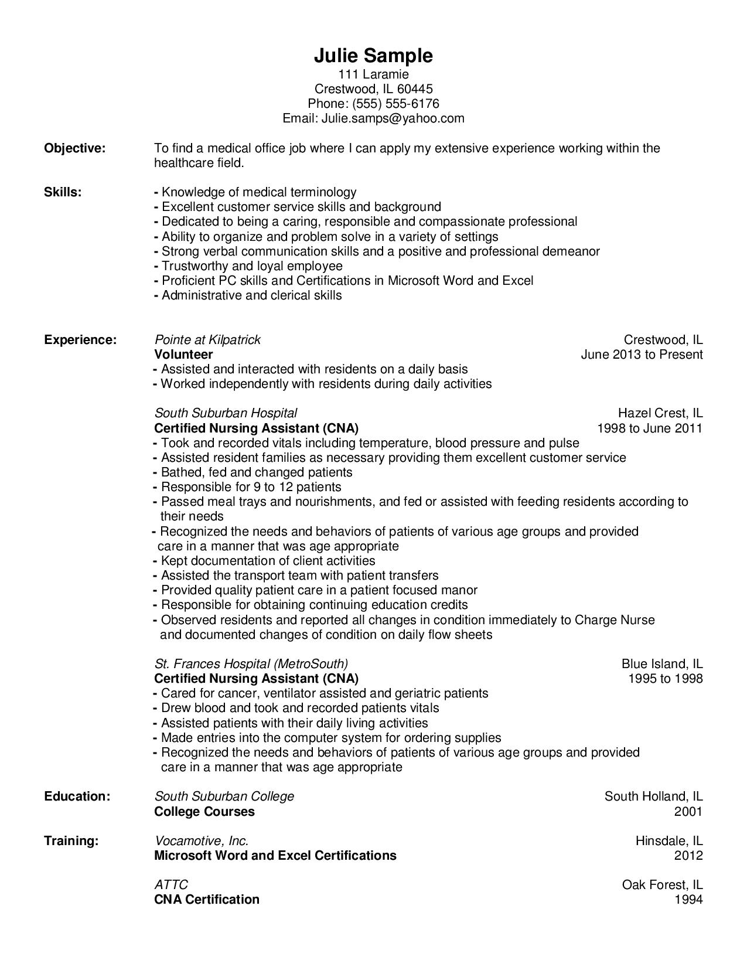
Example of an outdated resume format.

Slide 7
So what do new (and improved) resume formats look like?

Slide 8
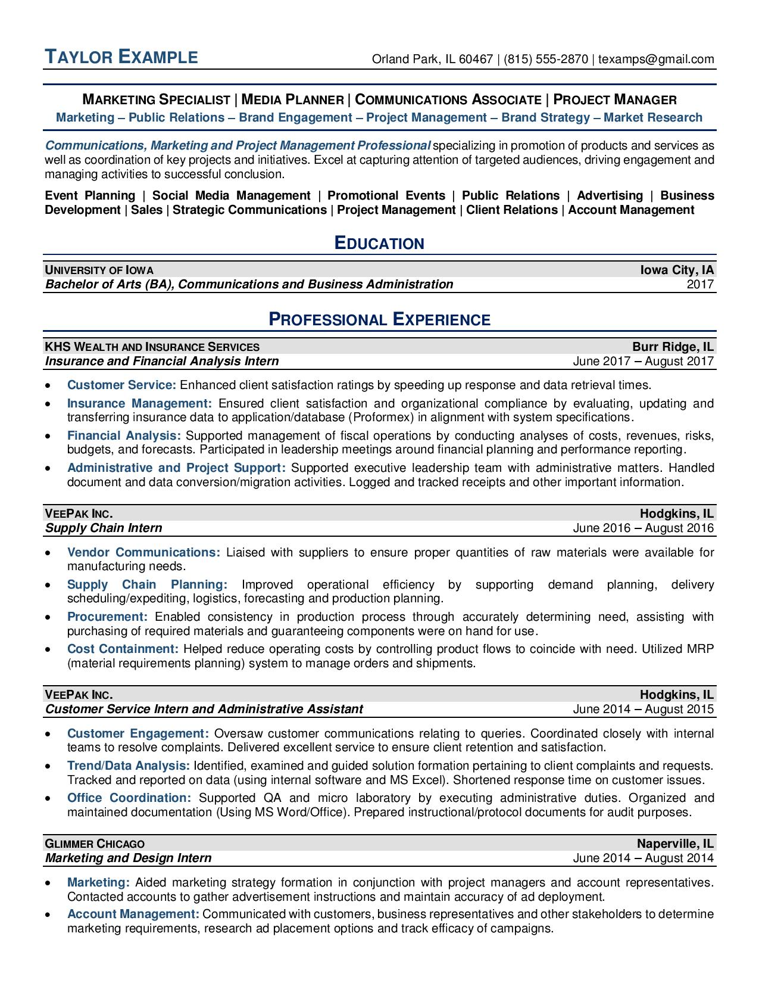
Example of a modern bulleted resume format.

Slide 9
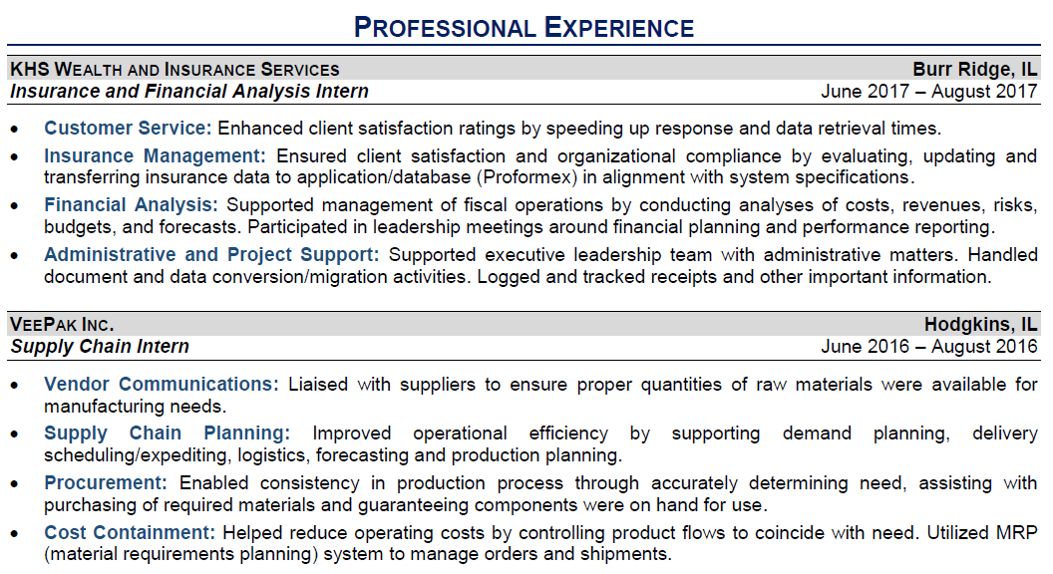
Closeup of experience (modern bulleted format).

Slide 10
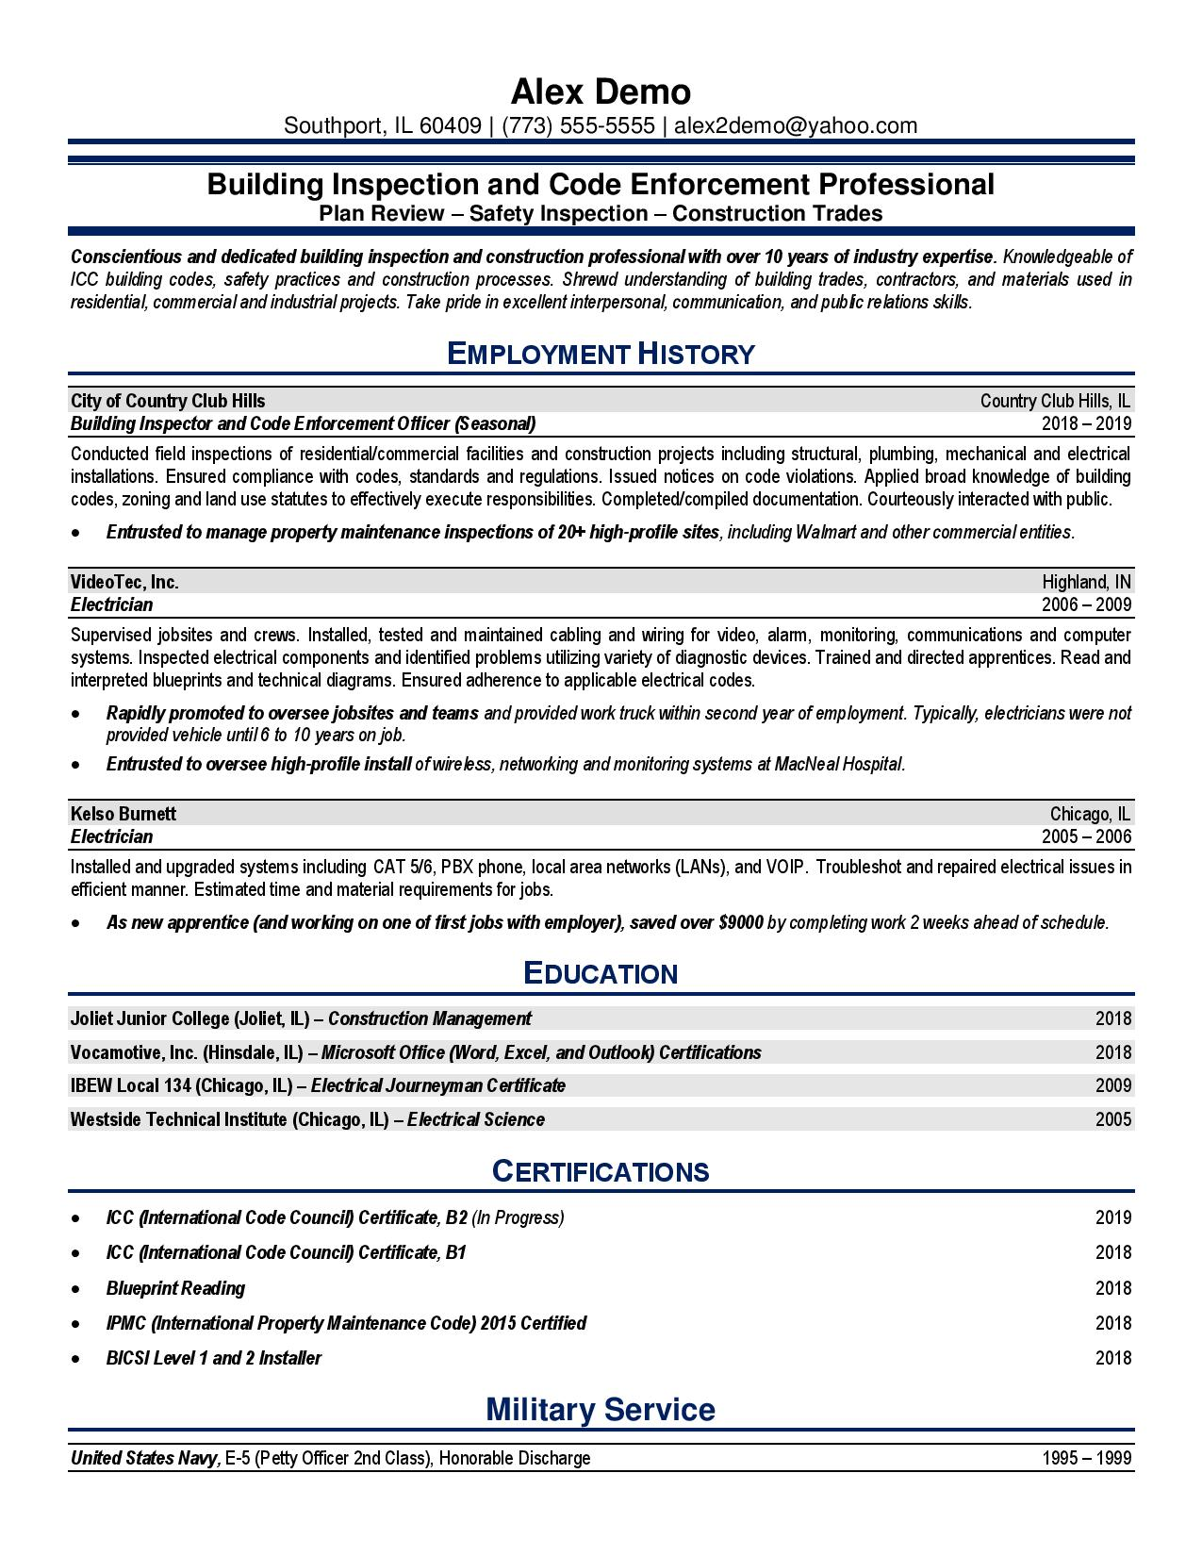
Example of a modern hybrid (paragraph/
bulleted) resume format.

Slide 11
Closeup of experience (modern hybrid format).

Slide 12
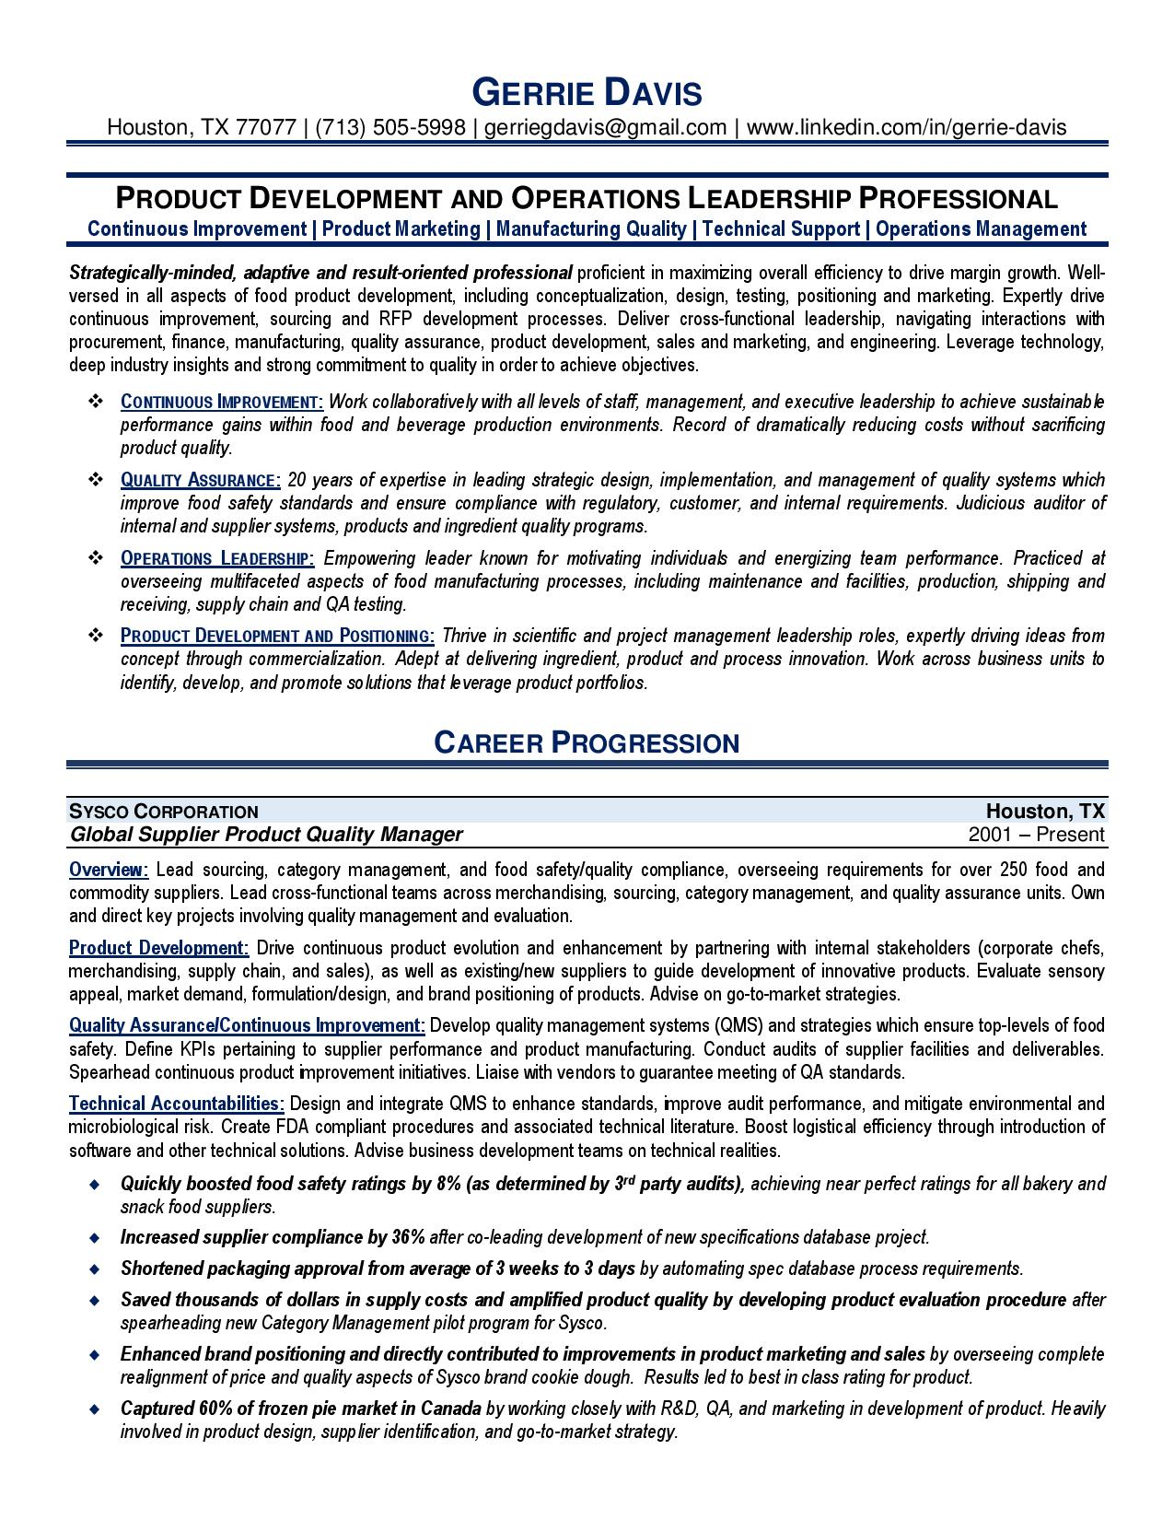
Example of a modern (complex) hybrid (paragraph/
bulleted) resume format.

Slide 13
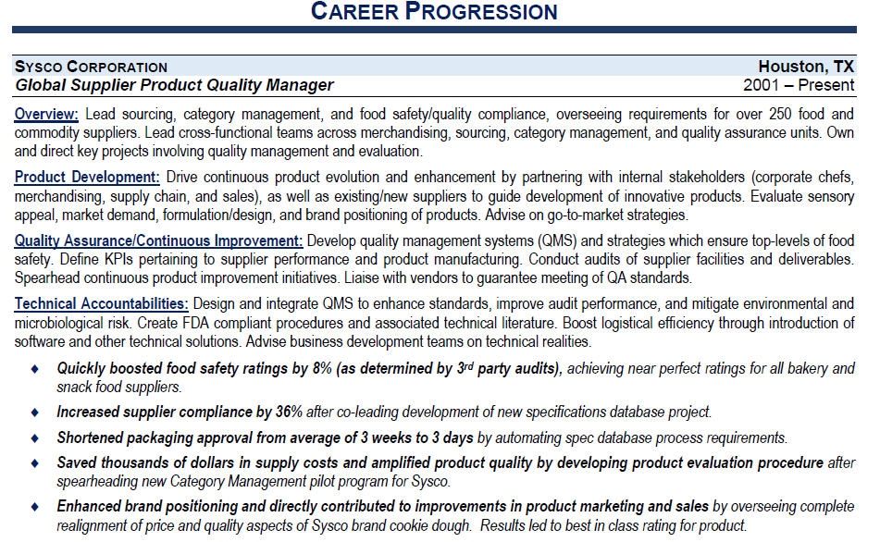
Closeup of experience (modern complex hybrid format).

Slide 14
Modern Bullets or Modern Hybrid Formats - Which format should you use for your clients?

Slide 15
Writing and Style
Before examining individual resume components, let’s start by defining the product as a whole. In short, excellent résumés are sales-focused, relevant, visually appealing, quality-oriented, and succinct.
The following writing tips are espoused by the National Résumé Writers’ Association (NRWA) in accordance with its Writing Excellence standards.

Slide 16
Writing and Style
Sales-Focused
Sell benefits instead of features.
Use action/active verbiage.
Emphasize successes, contributions, and achievements.
Exude quality and project the appropriate “image.”

Slide 17
Writing and Style
Relevant
Emphasize key information and keywords.
Prioritize qualifying data.
Exclude or de-emphasize non-relevant information or include only pertinent information that targets the job.

Slide 18
Writing and Style
Visually Appealing
Utilize classic design elements.
Use white space effectively.
Complement the client’s profession through appropriate page design and paper choice.

Slide 19
Writing and Style
Quality-Oriented
Meticulously proofread and error-free.
Consistent in formatting, capitalization, punctuation, number use, line spacing, and abbreviations.
When printed, done so in a high-quality manner on laser or laser-quality printer. When prepared for digital distribution, the document should be created in a universal format.

Slide 20
Writing and Style
Succinct
Present information in first person (without personal pronouns such as “I” or “my”).
Use a telegraphic writing style (with limited use of articles—”the,” “an,” and “a”).
Avoid overwriting and verbose or pretentious language.
Exclude extraneous data that does not support candidacy.

Slide 21
Writing and Style
Section/Category Positioning
Category position should strategically place the candidate’s best qualifications first based on the match between their background/experience and the target position.
Manipulate the order of categories to best sell the candidate’s relevant qualifications. In most cases, a new college graduate will list education first.
If the candidate has a strong, relevant work history, placing the professional experience section before education will help the new graduate compete with experienced professionals and not be discounted as an “inexperienced recent graduate.”

Slide 22
Writing and Style
Date Positioning
Positioning of dates can either highlight or take focus away from a candidate’s work history.
Drawing the dates out to the right makes them more visible and can emphasize a candidate’s strong loyalty and solid work history.
If the candidate has short stints of employment, consider moving the dates in to just behind the title or company name.
Eliminating months creates a more consistent history and is standard on many résumés.*
As dates are almost never a better selling point for a candidate than job title, avoid putting dates along the left margin where the reader’s eye is naturally drawn first.

Slide 23
A section by section break down of a modern resume.

Slide 24
The Header

Slide 25
Important Elements:
Formatting
Full Name (and Credentials)
Location or Address
Phone Number
Email Address
LinkedIn URL*
(Live Link Issues)

Slide 26
The Summary

Slide 27
Important Elements – Headline and Summary
Heading and Subheading
Summary Paragraph (Impact or Positioning Statement)
The summary statement should be used to distinguish the candidate in the job market.
Ask yourself the following:
What qualifications and abilities set the candidate apart from other job seekers?
What uniquely qualifies the candidate to solve the employer’s problems?
These attributes should be emphasized and illustrated throughout the résumé, but also highlighted in the summary statement. Use the summary statement to establish the candidate’s value proposition and to distinguish them from the vast pool of job seekers.

Slide 28
Important Elements – Finishing Off the Summary Section
3 Options for Completing the Section:
Basic: Expertise or Skills Keywords
Intermediate: Skill/Experience Statements with Support
Advanced: Career Highlights which Tie-in Expertise

Slide 29
The Experience

Slide 30
Important Elements – Job Descriptions
Job descriptions should never “parrot” the official job announcement or simply list job duties.
A job description must convey value by revealing relevant challenges, actions, and results using “action” verbs and quantifiable information – not vague statements.
A strong job description prioritizes information in accordance to employer needs. It also uses keywords relevant to the target industry.
Paragraphs are concise, categorized by function, and written in first person without the personal pronoun.

Slide 31
Important Elements - Achievements
Frontloading accomplishments and following with the why and how not only makes for a more interesting read but it makes sense because the reader scans from the left to right.
To capture attention quickly, all quantifiable data should be positioned at the start of each accomplishment (unless there is a good reason not to do so).
For Example:
Instead of writing: “Designed new sales training program which resulted in employees selling 50% more each year.”
Try this: “Increased revenue 50% by designing new sales training program which amplified individual sales rep performance.”

Slide 32
Education and Professional Development

Slide 33
Important Elements - Education
Dates – to list or not to list?
Order of education.
Use of “coursework.”
Incomplete education.
Irrelevant education.
Abbreviations.

Slide 34
Important Elements - Certifications
Dates – to list or not to list?
Certification issuer and abbreviations.
Expired certifications.
Irrelevant certifications.

Slide 35
Important Elements - Trainings
Dates – to list or not to list?
Training provider.
Name and description of training.
Irrelevant trainings.

Slide 36
Other Things Found on Résumés
Maybe Include…
Volunteer Work
Board Work
Skill Section
Tech Proficiencies
Publications / Media References
(Almost) Never Include…
Interests Section
References
Highly Personal Data
Picture

Slide 37
Applicant Tracking Software (ATS) Systems

Slide 38
What is an applicant tracking software system?
An Applicant Tracking Software (ATS) system is just one part of an HR management software package.
They are intended to streamline the hiring process.
They also drive websites of companies, recruiters, and even job boards like Indeed, Monster, Career-Builder, The Ladders, Glassdoor, LinkedIn, etc.

Slide 39
The ATS Engine:
Behind every ATS is an “engine” that runs the parsing, scoring, and keyword searches.

Slide 40
Recent ATS Changes:
The number of companies using ATS systems.
The types of companies using ATS systems.
The sophistication of ATS systems.
Artificial intelligence and concept searches.
The format requirements for resumes.

Slide 41
What does this mean for you and your clients?
Everything has changed in recent years!
From the mid-1990s until about 10 years ago, most résumés were mailed/faxed and then scanned into ATS systems, so the format of résumés was critical.
Today, electronic files that are uploaded into ATS systems are read electronically, not using OCR (optical character recognition).
That means fonts, underlining, graphics, lines, white text, etc., are no problem for modern ATS systems.

Slide 42
Text matters, not format codes.
Formatting codes are ignored by these new-generation ATS systems, so italics, bold, underlines, and hyperlinks are fine to use.
Today’s ATS systems are very different from the old ones. It’s not about the way the resume format looks on paper but how it was formatted “underneath.”
This allows you more design freedoms. However, you still need to be a method and consistency to your resume design which the system can interpret.

Slide 43
2 types of ATS systems:
The first type of ATS system runs simple keyword searches and does not look for concepts.
The second type of ATS is concept driven, although it still uses keywords as the basis of its search methods. This semantic search is more like artificial intelligence.

Slide 44
Simple Keyword Searches:
A good way to think of these is like the search feature in Windows.
You enter a term like “project coordination” and every document on your drive with those two words pops up.
Systems use data logic with operators like “and” or “or” to tie words together and create more sophisticated searches, but it still comes down to a simple keyword match.

Slide 45
Concept-based Searches:
These think more like a human being, using concept-based searching, sometime called “semantic” searching.
Can interpret the meaning behind words and concepts.
Ranks resumes based on how relevant and recent a job seeker’s qualifications are. Information on page one is considered more recent and more relevant.
Recognizes alternate job title names, related skills, relationships between concepts, and punctuation variations.
Can assume that keywords like “project coordination” are a match even though the sentence in the resume reads “Coordinated complex construction projects….”
It still comes down to identifying keywords first.

Slide 46
Common Questions:
What if a keyword is spelled wrong in the job lead and the resume spells it right? Will it be considered a “hit” in a keyword search?
NO!
What about abbreviations? If “research and development” are keywords on a job req, what happens if the resume says R&D instead?
Synonym dictionaries are powerful enough to see these as the same. When in doubt, spell it out, or use them both.
What about the difference between MBA and M.B.A. or BS versus Bachelor of Science?
Generally not a problem. Again, use both if you are not sure.
Are cover letters considered in keyword searches?
No! And it hurts your resume’s score if you make the first page of your resume the cover letter.

Slide 47
More Common Questions:
Does the number of times a keyword appears in a resume affect its ranking during a search?
Yes!
What about the position of the keyword on the resume? Top, bottom, a list of keywords, or integrated into sentences?
The keywords on page one are scored higher than ones found on page two. A list of keywords isn’t penalized, though.
What if the job req requires experience with MS Word and the resume says “MS Office”?
Yes and no. It is always safest to list the parts of a software package.

Slide 48
Just a Couple More Items:
Integrate skills into the body of the work experience, even if you have a separate skills list.
Why? Because all ATS systems calculate number of years of experience with a certain skill from the dates in the work experience section.
For the same reason, never omit dates on experience.
Yes, that means functional resumes are not the way to go when applying through ATS systems.

Slide 49
Keywords are Critical!
Now that you know how ATS systems work, you understand how critical keyword selection can be to your client’s job search success.
When possible, your client should integrate keywords from the job lead into a customized résumé.
This is a burden, but one that can mean the difference between success and failure.
Knowing that, let’s spend help you understand what a keyword really is…

Slide 50
What are Keywords?
The “buzzwords” of your client’s industry.
Keywords can be nouns, adjectives, or short phrases.
They usually are not verbs.
They describe your client’s unique knowledge, skills, abilities, education, and experience.
And they are used to “score” or “rank” resumes.

Slide 51
Hard Skills (concrete, demonstrable):
MS Word
Forklift
Cash Handling
Project Management
Spanish
Well-known company names (Microsoft, Google)
Colleges or universities (Harvard, University of Illinois).

Slide 52
Soft Skills (hard to prove until hired):
Oral and written communication skills
Problem solving
Leadership
Team player
Productivity
Customer retention
Strategic planning
Performance

Slide 53
How Do I Find Industry Buzzwords?
Online job advertisements
Performance evaluations
Professional and technical associations
Dictionary of Occupational Titles (http://www.occupationalinfo.org/)
Recruiters and HR departments
Local government workforce centers

Slide 54
But the Most Important Source is…
The most important source for keywords is the actual job advertisement for which your client is applying.
Your client needs to make sure that he or she is using the keywords from that ad in the resume.
That means that every resume submitted needs to be customized for ideal results.
Training your clients to do this, or doing it for them, will significantly amplify results!

Slide 55
A Few No-no’s:
If your client doesn’t have an experience or skill, don’t use the keyword.
Don’t try to hide keywords so they can’t be seen by the naked eye by…
This includes using formatting “tricks” to confuse the ATS system.
Once a resume is parsed, all of these tricks are revealed and your client’s resume will be discarded.

Slide 56
Testing Resume Keyword Performance
Though free keyword testing sites is less than perfect, you can use sites like www.jobscan.co/ to see if you are in the right keyword ballpark.
You should be shooting for a 70-75% match on sites like this (Many ATS thresholds are at or below this).
Self constructed composite job leads (combining multiple leads into one document, eliminating redundancies, non-applicable words and filler) improves overall results.

Slide 57
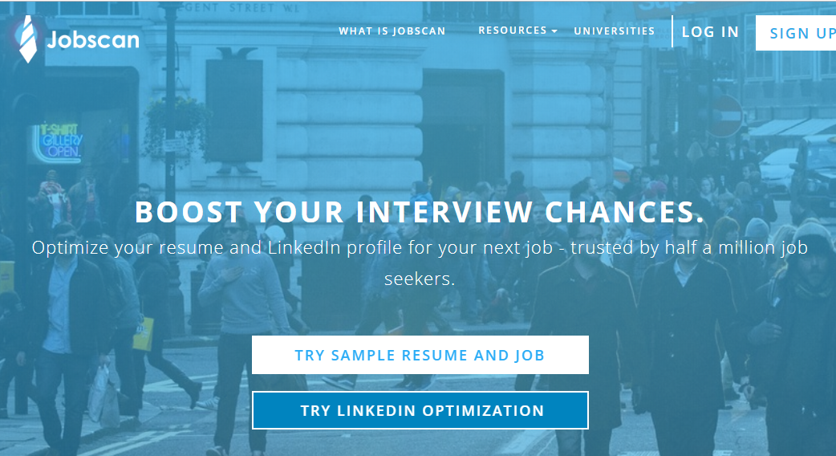
Testing Resume Keyword Performance

Slide 58
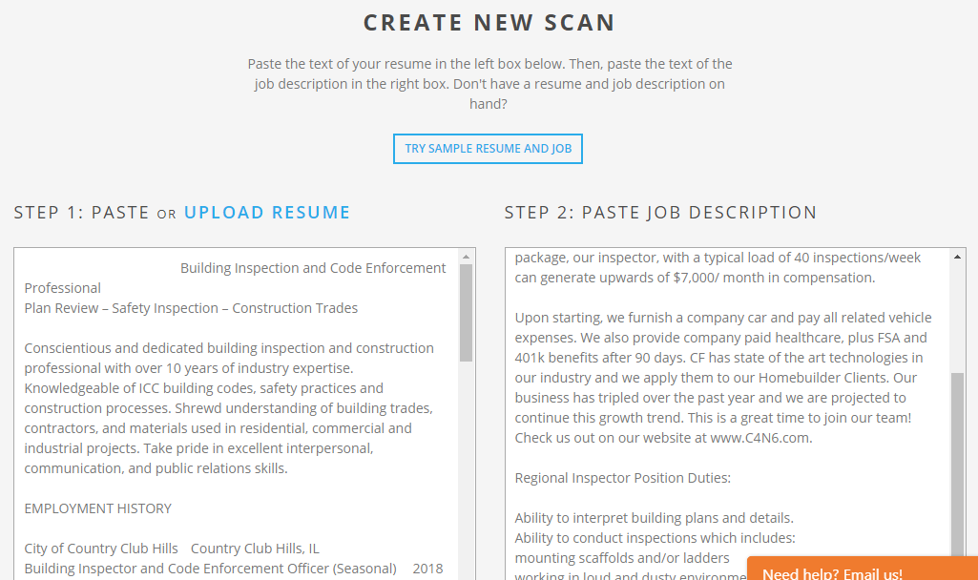
Testing Resume Keyword Performance

Slide 59
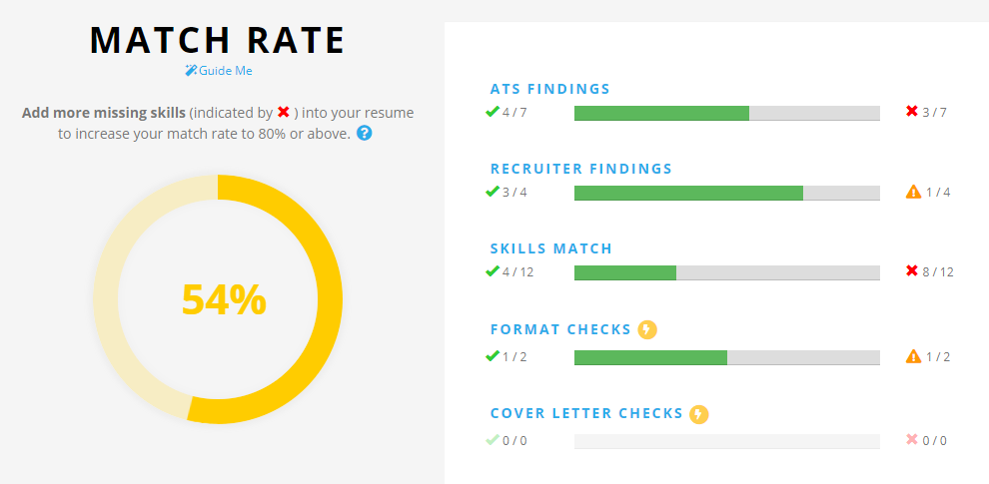
Testing Resume Keyword Performance

Slide 60
Testing Resume Keyword Performance
Jobscan does provide a report which can provide useful info beyond keyword matching alone. I don’t accept the results as gospel, but insights are given in areas including:
ATS FINDINGS
RECRUITER FINDINGS
HARD SKILLS/SOFT SKILLS MATCH
JOB RECOMMENDATIONS

Slide 61
Audience Questions?

Slide 62
Collecting Employment Data from Your Clients to be Used in Creating Resumes

Slide 63
Step 1: Collect a detailed job history.
This can be accomplished during:
Initial Evaluation/Client Interview.
Detailed Vocational Evaluation.
Client Orientation (Verbal or Written Process).

Slide 64
Step 2: Dig deeper into the client’s job history.
This can be accomplished with a resume focused questionnaire:
Either a General Questionnaire, or…
A 2 Part Questionnaire Process (Ideal):
Part 1: Get the client’s own reporting on their responsibilities and achievements.
Part 2: To ask specific questions of the client based on what he or she first reported.

Slide 65
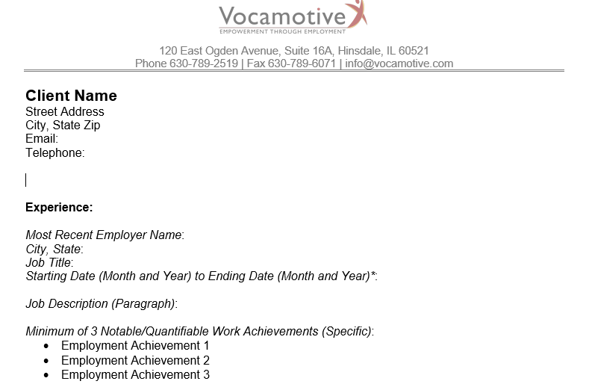
Questionnaire Part 1: Client self-reports his/her responsibilities.

Slide 66
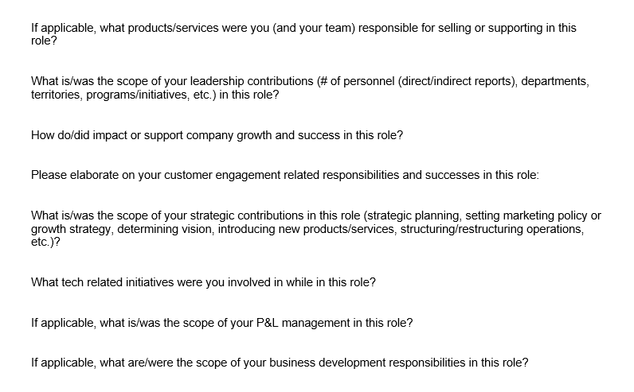
Questionnaire Part 2: You ask the client for specifics based on job targets.

Slide 67
Final Audience Questions?

Slide 68
Thank You!

