Slide 1
Job Analyses
The Crux of the Case

Slide 2
What’s the Big deal?
Describes job to the average layperson.
Can lead to claim closure if released for work.
Documents worker’s skills from the JAI.

Slide 3
Why do an on-site JA?
First-hand observation
Use of the JA kit
Documenting skills and duties
Testifying at the board – will your JA hold up?

Slide 4
When an on-site job analysis is not possible…
Employer is out of business.
Employer/TPA already has a job analysis on file.
Job is performed at inaccessible sights.
Employer won’t allow an on-site JA.
Verify, verify, verify!!

Slide 5
Effective Strategies for Interviewing Employers
Asking the right questions
Emphasizing the importance of the JA to the employer
Interviewing the right person for the job title
Schedule the JA at the right time of day
When an on-site visit isn’t possible, provide a careful interview

Slide 6
A picture says a thousand words
The Use of Photos
Providing a legible copy of the JA with photos

Slide 7
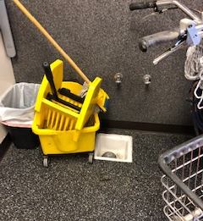

Slide 9
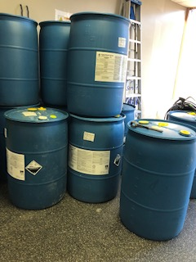

Slide 10
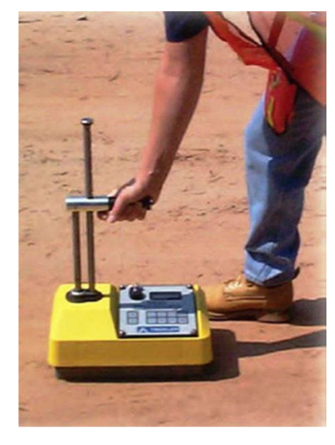

Slide 11
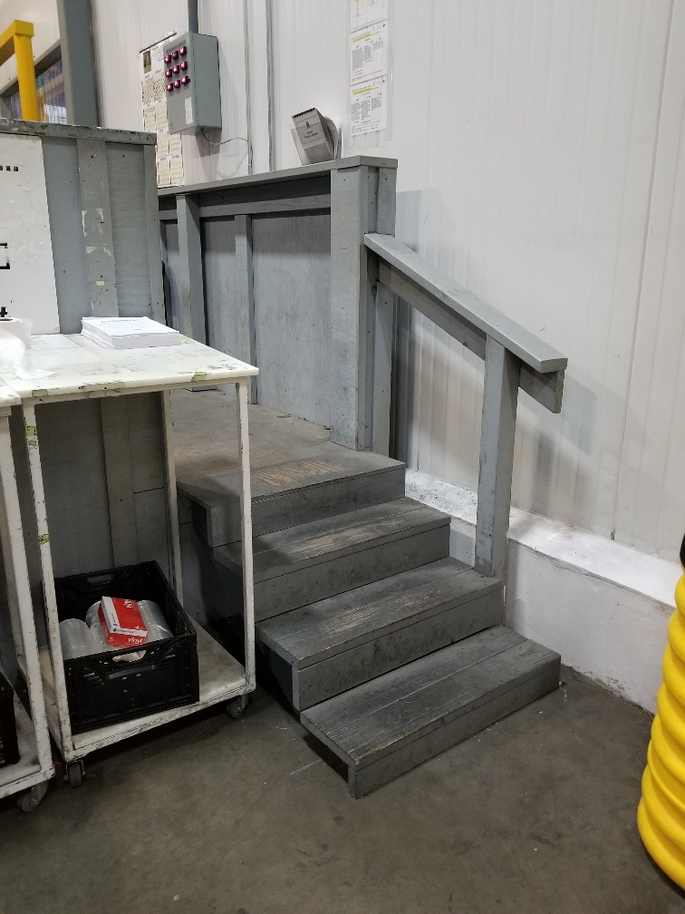

Slide 12
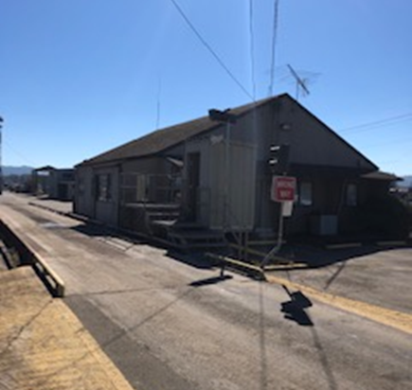

Slide 13
Transferable skills job analyses – setting the stage for the lms
- Ensure the job analysis is representative of the labor market for that position
1
- Choose the best transferable skills JA’s to send
2
- When in doubt, send it out! LMS can confirm skills later
3

Slide 14
Potential pitfalls
Using standard JA’s from the JA bank – OK, but verify!
Can’t reach the EOR? Ask the worker!
Conflict on the accuracy of the JA: What happens if the worker and employer don’t agree on the accuracy of the job analysis?

Slide 15
Job analyses formats/addendums
Too short, too long, or just right?
Using an employer’s existing format
Addendums: psych, upper extremity, chemical exposure
This Photo by Unknown Author is licensed under CC BY-NC-ND

Slide 16
turn job analysis work into a specialty: job analysis bank development light duty programs SAW/Preferred Worker
You’re an expert! Sell yourself!
Keep an eye out for the light duty conversation.
Do a great job, and follow-up regularly.

