Slide 1
Covid 19: Challenges and Coping in 2020: Using the Grief Model to Understand and Address Loss and Change in LNI Clients
Nora K Marks, Ph.D.
Columbia Basin Psychological Services
November 2020

Slide 2
The Grief Cycle
A cycle of grief and loss was developed in the 1960’s by Elisabeth Kubler-Ross to explain the grieving process.
Involved 5 stages: Shock & Denial, Anger, Bargaining, Depression, Acceptance.
Many clinicians began to notice that people who were faced with severe upheavals in their lives followed the same process. (Since then it has been widely utilized as a method of helping people understand their reactions to significant change or upheaval.

Slide 3
The Grief Cycle cont’d
When faced with a loss or a significant life change people often
Deny it’s happening or minimize the effects, sometimes unwittingly
They try their best to get back to the previous norm by altering some aspect of their lives/behavior
Once they accept that the change has occurred, Go through a period of time wondering why they have been the victim of this loss/change, what they did wrong
Feel guilty if they caused the change or angry if it was caused by external
Feel angry about the change or loss
Feel sad and as they realize it is permanent and grieve the loss of “what was”, say goodbye to life as it was

Slide 4
Grief Model, cont’d
If they are reasonably mentally sound, they make it through this process and adapt to the “new normal”
Takes anywhere from days to years
There are indicators of where someone is in the process, listen to what they say and watch what they do
It is a messy process, but normal for healing/adjustment
We can help by supporting, reassuring that it is normal and help them move through depression and anger stages rather than being stuck
Goal is to accept the new normal and get on with life

Slide 5
Grief Model, cont’d
The key is to start out by accepting them
where they are

Slide 6
Advantages of using grief cycle to explain adjustment to loss and change
Easy to understand: For client AND YOU as you cope with pandemic
Normalizes the process of adjustment: We all go through these. “I’m not crazy, a whiner, etc.
Gives workers a sense of hope :There is a beginning, middle and end
Considerable research to support: Kubler Ross and others
It is highly applicable to workers and ourselves during this unusual year of pandemic and political unrest as we all adjust to change

Slide 7
Grief Model, cont’d
The grief model is in sync with the new VR procedures:
Take client where they are
The recovery from injury is a process
Prevent a confusing process
Discuss modifications
Help prevent unrealistic return to work plans or expectations

Slide 10
Why the grief model? Cont’d
It’s valid and simple and easy to understand-this is important enough to talk about on its own
We (all) need to reduce cognitive demands when under stress
Increased demands=less energy to put into learning new information.
Try this: -tap your foot once per second
-now say the ABC’s aloud at the same time
-now sum the numbers I read off while doing all the above
Familiar, low demand tasks are easier under stress of injury, loss and change, maybe can even multitask but add a new unfamiliar task and the cognitive processing breaks down

Slide 11
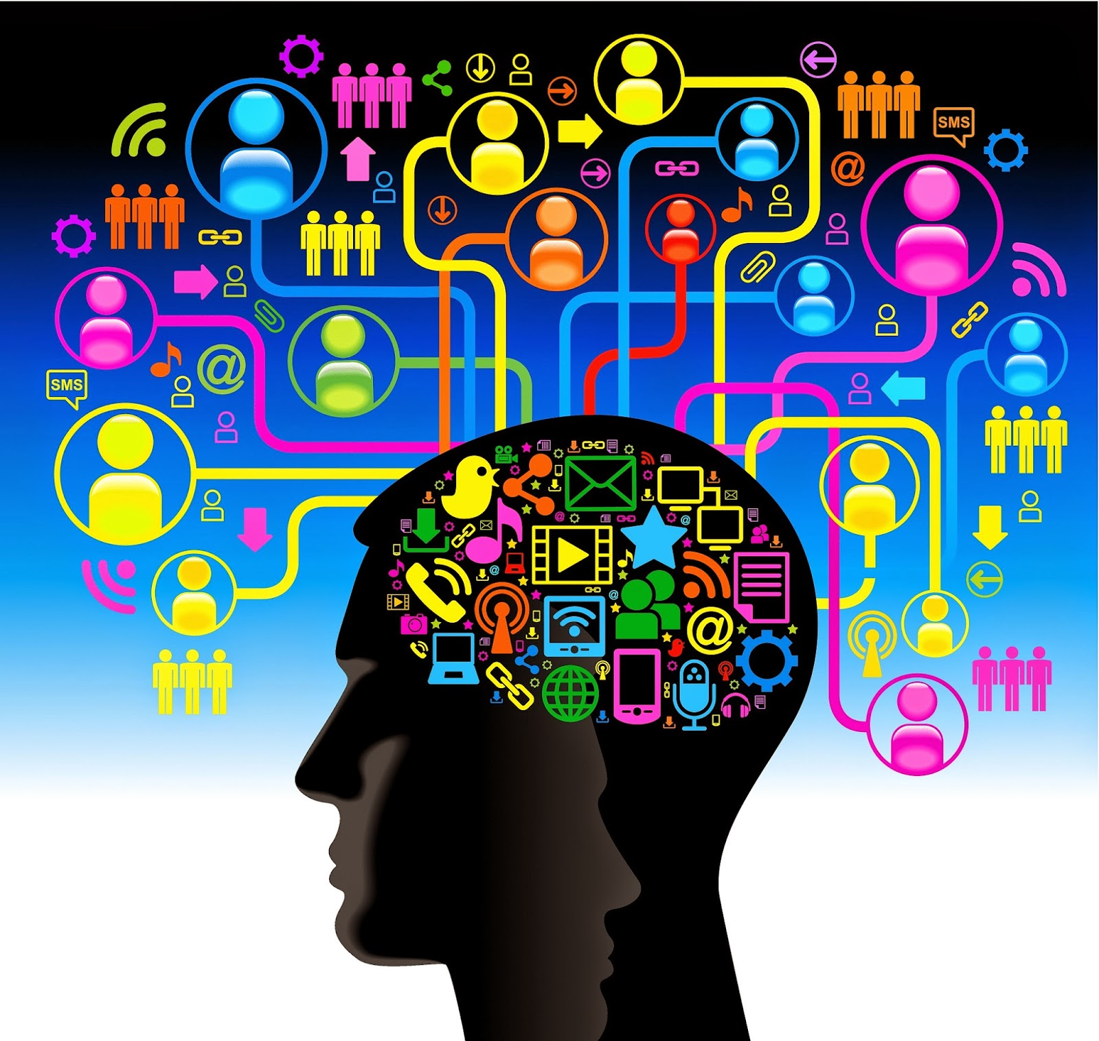
This Photo by Unknown Author is licensed under CC BY-SA-NC

Slide 12
Why grief model? Cont’d
Bottom line: It’s hard to learn new coping skills when you are adjusting to change or under stress
Simple models are the best for us and (right now) the clients

Slide 13
Why the grief model? Cont’d
What are some changes/losses you can think of that your clients are going through as a result of their injuries or accident?
Respond in chat

Slide 14
Why the grief model? Cont’d
Here are some I have heard over the years:
Loss of who I was before
Loss of status
Dealing with chronic pain/Loss of pain-free life
Change of role in family/community
Loss of ability to care for oneself/independence
Experiencing medical procedures/trauma with no prior medical history
Dealing with LNI system
Loss/significant change in income
Mental health symptoms
Issues of aging, mortality, death

Slide 15
The Grief Model, cont’d
“I used to go to work in the fields, at 4 in the morning and work all day….I loved my job, loved being outside. We used to have contests to see who could pick the most apples and I usually won. I’d get home and eat dinner and then go to my next job as a janitor. On the weekends, I’d play soccer or go help my brothers or my friends with their houses. Sometimes I’d help my cousin with his landscaping business. My kids got everything they needed and wanted. They never had to work. I wanted them to go to school. Now, my wife works and is tired all the time. My back hurts and I can’t help out around the house. I don’t know how to cook or do laundry very well. My kids suffer and I feel terrible.”

Slide 16
The Grief Model, cont’d
That was real content from one client, applies to many of my field worker/laborers.
What have you heard that is similar? Respond in chat

Slide 17
The Stages of Adjustment to Grief and Pain
Denial
What you will hear: “Can’t believe this is happening”, “I’ve been through worse, this will get better”.
What they will do: Miss appointments, avoid talking to/interacting with friends, family. Sometimes try to carry on as normal and get reinjured or spend days in pain.
Juan: “I can cut my lawn but then I spend the next two days in bed.”
Dale: “Hunting is very important to me and my family. It’s a tradition. I went hunting last weekend but took extra pain pills to get through it. I was out of pain meds when I got home, so I stayed drunk for 3 days just to manage the pain.”
What they feel: Usually numb, shock, can’t get their heads around the severity of injury

Slide 18
The Stages of Adjustment to Grief and Pain, cont’d
Stage 2: Pain and Guilt
What they say: “I’m no good to my family”, “I’m a burden”, “Why me? I’m a good Christian (Muslim, Baptist, citizen, brother, worker.) “Why did God let this happen to me?”
Bob: “I was ready to retire and wanted just one more job for a couple of years to pay off our house. Then this happened.”
What they do: Isolate, talk about the injury/situation over and over
What they feel: Intense emotional AND physical pain. Begin to feel the anger and depression that are the next phases.
How to help: Listen, confirm their feelings, remind this is a process with an end. Reassure this is not their fault, that they can find meaning in their lives again, but it will take time.

Slide 19
The Stages of Adjustment to Grief and Pain, cont’d
Stage 3: Bargaining and Anger-I think of these as 2 different stages
Bargaining
What they say: “If I go through all this medical treatment, I’ll be fine. I just have to get through it.” “I promise I’ll go to church every Sunday.” “I’ll be better in a few months, so I just have to fake it on my job until I’m better.” “Our company is like family, so they’ll accept me as I am until I’m better”, “there will be a miracle treatment to help me.”
What they do: Still a lot of denial, but try to figure out ways to return to “old normal”, act upbeat, sometimes reject help from us
What they feel: Varies a lot: scared, sometimes overconfident, overly positive
How to help: Listen, confirm their feelings, remind this is a process with an end. Applaud their efforts to get better. Gently urge patience and realism without giving up hope.

Slide 20
The Stages of Adjustment to Grief and Pain, cont’d
Anger
The beginning of the crash
What they say: “Someone is going to pay for what happened to me!”, “You don’t care about my pain!”, “This is unfair! The whole system stinks!” “I look at everyone else having a good time and I hate them!” “I hate God. I don’t believe anymore!”
What they do: Blow up at providers and family, sometimes can become violent, force themselves to do things that hurt, yell at people they don’t know. Begin to isolate or isolate more, drink or use other substances to calm down.
What they feel: Intense anger, resentment, frustration, hatred of self and others.
How to help: Listen, confirm their feelings, remind this is a process with an end. Make sure they are not a danger to self or others. Remind them LNI does not hate them personally. This is where meds usually come in.

Slide 21
The Stages of Adjustment to Grief and Pain, cont’d
Depression: The bottom of the crash
They can move back and forth between anger and depressive phases
Depression and anger phases often the longest phases. Our goal is to move through these phases and move towards
What they say: I feel worthless, I feel sad, I don’t do the things I liked doing, no appetite, I sleep all the time, I cry over everything, or I blow up and everything annoys me, I wonder if my family would be better off without me
What they do: Cry, isolate, push family members away, hide, avoid friends, sometimes attempt or contemplate suicide, sometimes blow up at family or in stores or clinics, no longer go to family events, sometimes miss appointments with us (often), avoid talking about the accident/event, sleep a lot or none at all, over eat or don’t eat

Slide 22
The Grief Model, cont’d
What they feel: Guilt, hopeless, sad, confused, worthless, overwhelmed
How you can help: Listen and empathize; support and encourage; point out the positive things in their lives (healthy kids, they can still walk, they can still think, they have food and shelter right now), urge mindfulness, one day at a time, make one small improvement every day, “this too shall pass”, focus on their strengths, give a sense of hope, reinforce small efforts, encourage building support systems, help them learn to do things in a different way so they can be more empowered and independent

Slide 23
Grief Model ,cont’d
The Upward Turn
Often incremental, then builds over the next few weeks
What they say: My week hasn’t been so bad, I found a way to do something, I tried what you suggested, I stopped my negative thoughts and tried to focus on positive, I actually got something done last week, I only cried once last week. I need to just get used to…(pain, walking with walker, forgetfulness)
What they do: Make small efforts to accommodate new normal (office chair to fold laundry, unload dishwasher), take a short walk outside, showered, helped my husband/wife more
What they feel: Sense of hope, accomplishment, pride, look forward to a future, they can find meaning in their accident and lives

Slide 24
The Grief Model, cont’d
Two case studies if we have time:
John, severe arm injury, trauma
Ellen, bus driver, accident, head injury, back injury, trauma

Slide 25
Grief Model in the Age of Covid
Both society and individuals have gone through this model with the Covid pandemic
Denial
Bargaining
Anger
Depression
Additional stressors: Contentious political races, fires and smoke
We are moving slowly toward acceptance “It’s not going away”
Problem solving and resolution

Slide 26
Grief Model in the Age of Covid cont’d
Confusion/lack of information and knowledge complicated our accommodation to the new normal, along with other stressors
Our usual coping skills are gone (social, physical)
Respond in chat:
Can you tell which stage of this model you are in?
What disruptions have you had in your life?
What are your losses
How has your learning/functioning been affected?

Slide 27
Take care of the caretaker
Don’t expect to be at 100% learning/functioning
Establish a routine and try to stick to it
Sleep will be affected-dreams, quality, amount
Find alternative ways to interact with others
Mindless activities are okay if they help you cope (crossword puzzles)
Learn something new (EdX, Allison University online, or CE’s ie: CE’s for less)
Be patient with yourself

Slide 28
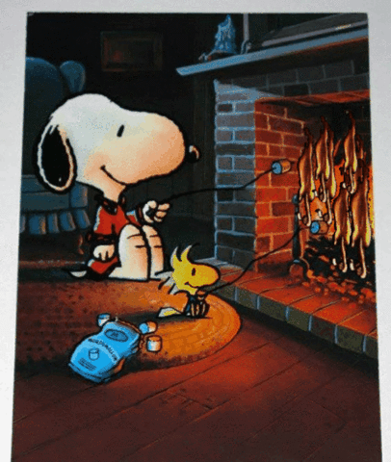
Its time to be happy again

Slide 29
Resources and References
Excellent model of change curve:
https://www.exeter.ac.uk/media/universityofexeter/humanresources/documents/learningdevelopment/the_change_curve.pdf
Good online resource:
https://www.change-management-coach.com/kubler-ross.html
Also research Motivational Interviewing-excellent approach to help move from resistance to change

