Slide 1
Using JAN to Assist Workers Return to Work
Matthew McCord, M.S., CRC
Motor Team Consultant
(800) 526-7234 (Voice)
(877) 781-9403 (TTY)
jan@askjan.org

Slide 2
Job Accommodation Network
Overview
JAN Services
Common Questions
JAN Website Tour
Interactive Process

Slide 3
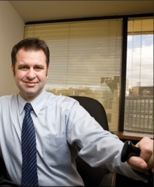
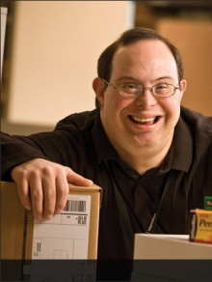
Job Accommodation Network
Consultation
Employment Legislation
Americans with Disabilities Act
Rehabilitation Act
Job Accommodations
All job categories
All impairments
All industries

Slide 4
Job Accommodation Network
Technical Assistance
Confidential
National
Easy to Use
Audience Focused
Employers
Individuals
Service Providers
Others

Slide 5
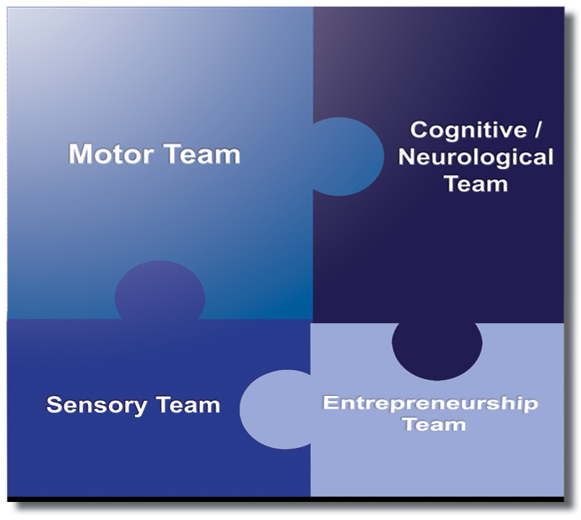
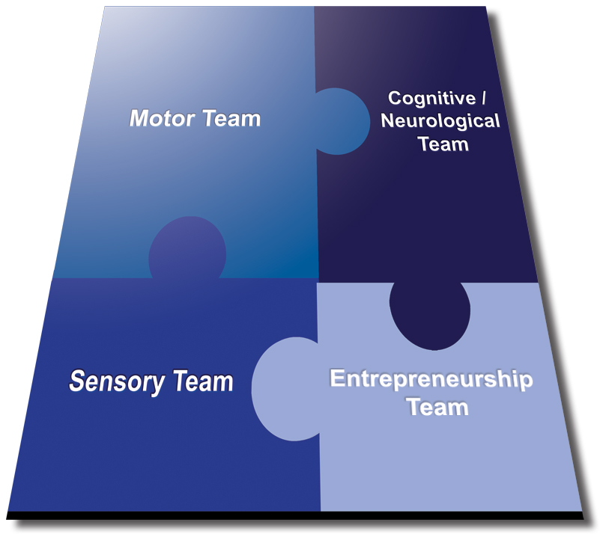
Job Accommodation Network

Slide 6
Common Questions
Common Questions

Slide 7
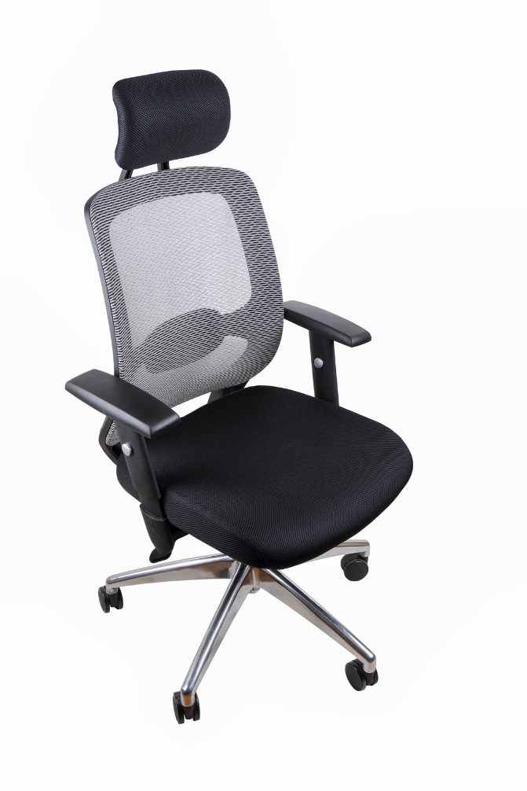
Common Questions
Motor Team FAQs:
Ergonomic Chair Requests
TIPS
Remember basic ergonomic principles.
Existing chair may be appropriate, but other needs could be causing the problem.
Discuss what specifications the individual needs from the chair.
Arm rests, more padding for seat cushions, footrests due to feet not reaching the floor.
Substantiate the need for the chair by linking it to the disability that requires it.

Slide 8
Common Questions
Motor Team FAQs:
Computer Use Accommodations
TIPS
Be aware of compatibility issues when considering Speech Recognition software.
Ensure the individual is properly trained in using the accommodations provided.
Various alternative input devices allow computer use without using hands.
Head movement, Eye movement, Feet.

Slide 9
Common Questions
Motor Team FAQs:
Restroom Access Accommodations
TIPS
Moving the workstation and allowing a private restroom is often helpful.
Flexibility in schedule can be beneficial to allow individual to make up time spent not working due to restroom usage.
If the job is compatible, working from home can be very helpful to consider.

Slide 10
Common Questions
Cognitive Team FAQs:
Accommodating Stress Intolerance
TIPS
Identify the specific triggers that cause the stress, then seek accommodations to better manage them.
If trigger is a job duty and no form of accommodation will help them manage, consider reallocating the duty if it is not an essential job function.
If it is an essential function and nothing will help them manage – reassignment.

Slide 11
Common Questions
Cognitive Team FAQs:
Service Animals as an Accommodation
TIPS
Under Title I of the ADA, service animals are forms of accommodation. This means they are reviewed like all other accommodations.
Employers have right to ensure the animal is able to perform the task the individual needs them to do and will not be a disturbance.
Title III of the ADA handles service animals differently. Be aware of whether the work area is considered a public space.

Slide 12
Common Questions
Cognitive Team FAQs:
Leave and Schedule Modification Requests
TIPS
ADA leave can be used intermittently or continuously.
There is no set amount of ADA leave usable per year like under FMLA.
A flexible schedule accommodation can be provided by allowing the time away be made up, or by using intermittent leave to cover the time away.

Slide 13
Common Questions
Sensory Team FAQs:
Accommodating Allergies
TIPS
Remove the allergen.
Change cleaning products used, remove air fresheners, increase frequency of cleanings.
Remove employee from area.
Move workstations, create latex-free zones within hospitals, allow working from home.
Reduce exposure as much as possible.
Provide air purifiers, allow breaks away from area, modify schedule if allergen is coming from co-workers.

Slide 14
Common Questions
Sensory Team FAQs:
Hearing Aids and Phone Use
TIPS
Understand the type and features of the hearing aid to ensure the options being considered will work with them.
Bluetooth-compatible hearing aid users can benefit from a Bluetooth streaming device to directly connect the phone and the hearing aid together.
Hearing aids users without Bluetooth features may benefit from a “hearing aid compatible” headset

Slide 15
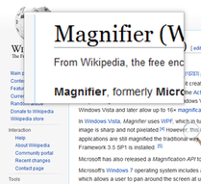
Common Questions
Sensory Team FAQs:
Low Vision and Computer Monitors
TIPS
Larger monitors and external screen magnifiers are popular options, but may not be long-term solutions.
It can be helpful to adjust system settings to increase the sizes of icons, text, and the mouse pointer on screen.
The use of screen magnification software (Zoomtext), and screen reading software (JAWS) can also be very helpful to consider.

Slide 16
JAN Website Tour
JAN Website Tour

Slide 17
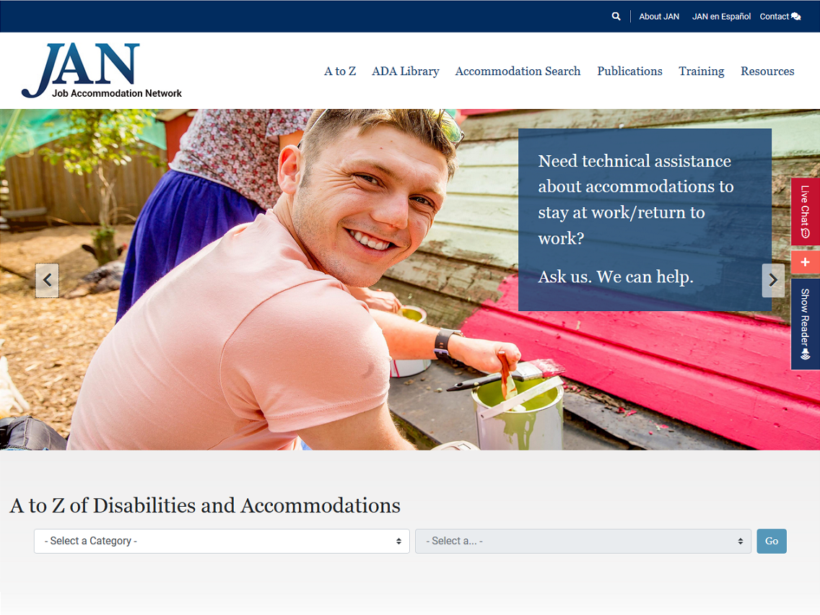
JAN Website Tour

Slide 18
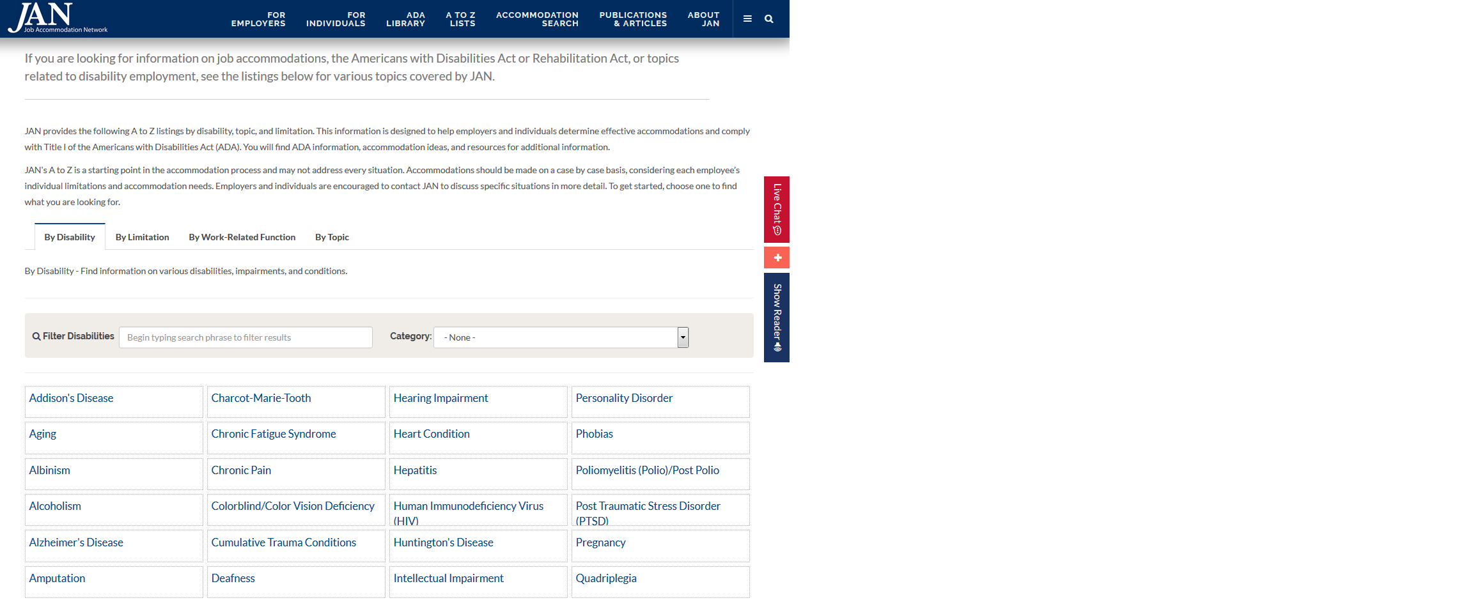
JAN Website Tour

Slide 19
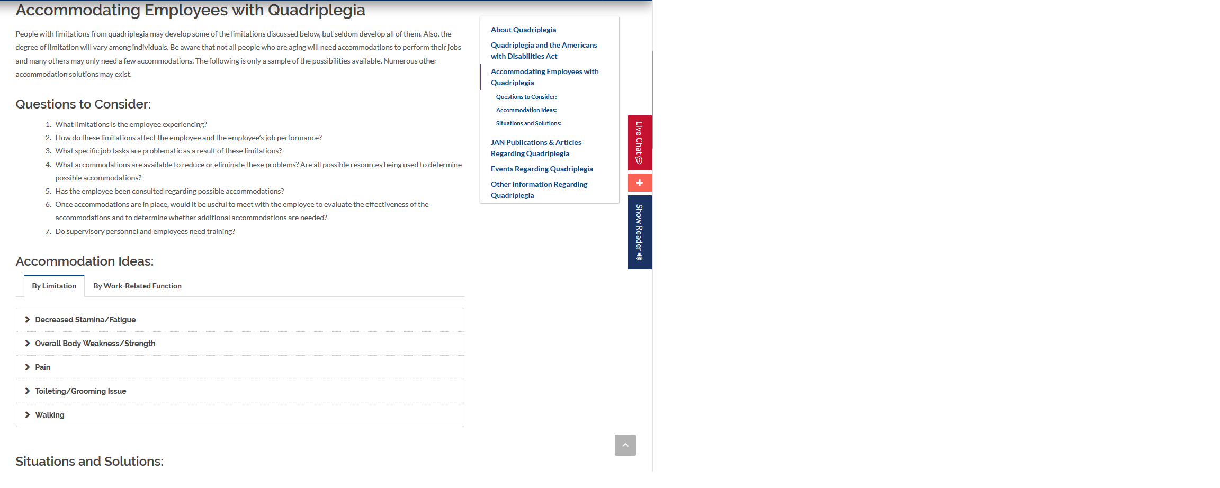
JAN Website Tour

Slide 20
JAN Website Tour

Slide 21
JAN Website Tour

Slide 22
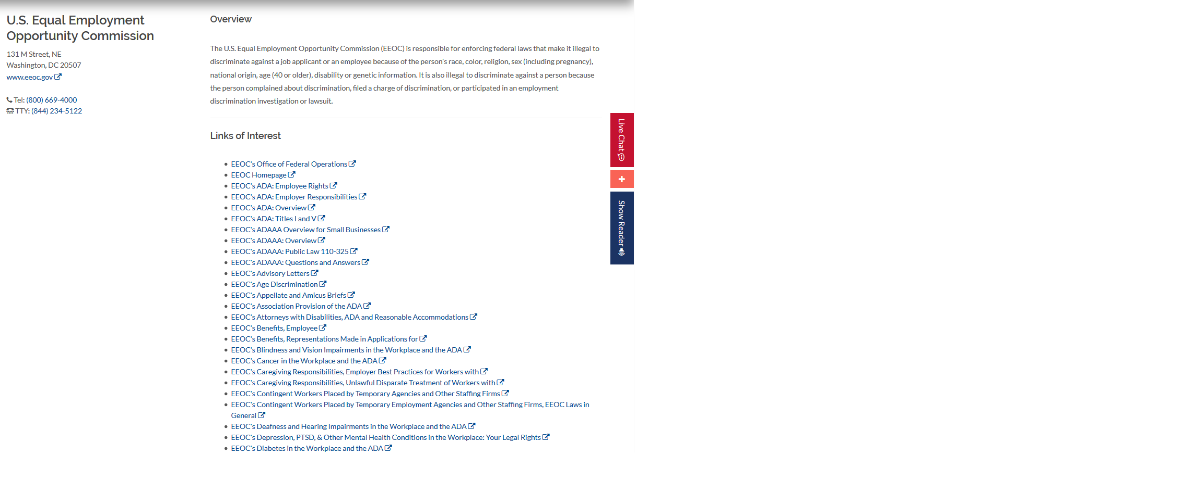
JAN Website Tour

Slide 23
JAN Website Tour

Slide 24
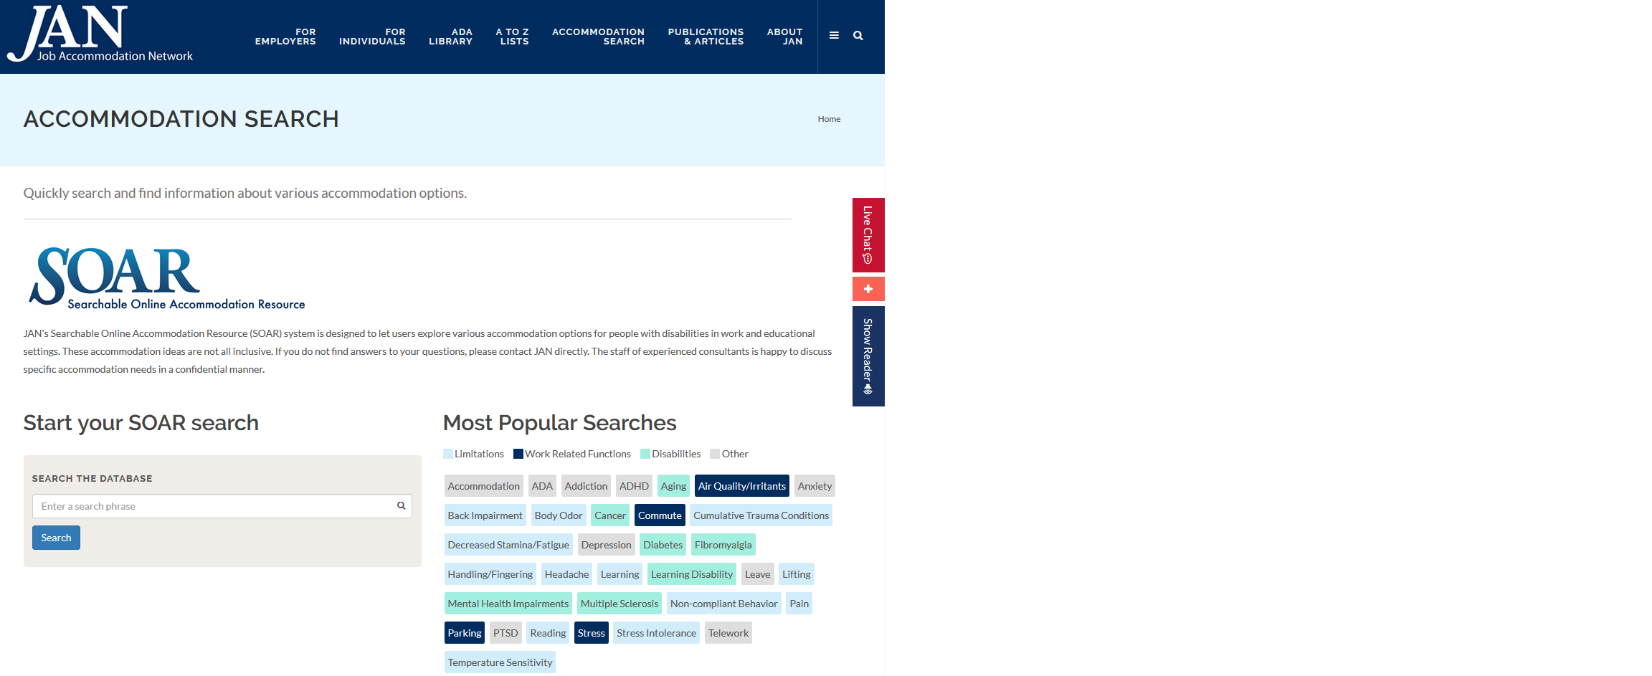
JAN Website Tour

Slide 25
JAN Website Tour

Slide 26
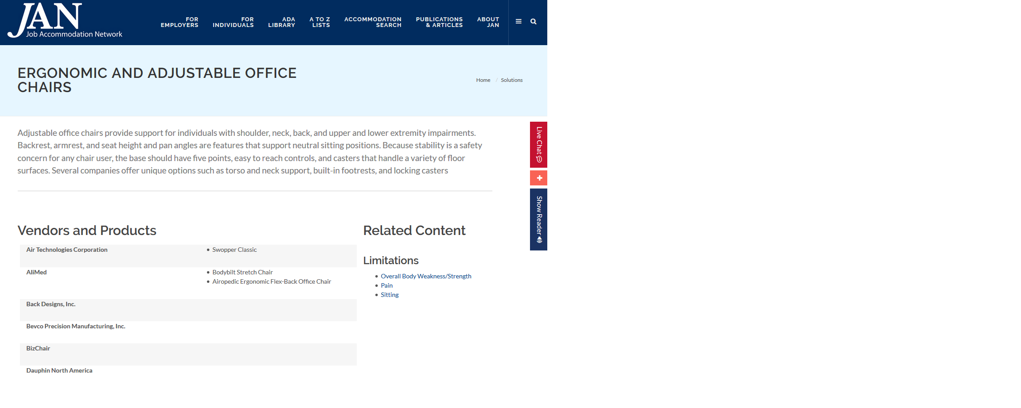
JAN Website Tour

Slide 27
JAN Website Tour

Slide 28
JAN Website Tour

Slide 29
JAN Website Tour

Slide 30
JAN Website Tour

Slide 31
JAN Website Tour

Slide 32
JAN Website Tour

Slide 33
JAN Website Tour

Slide 34
Interactive Process
Interactive Process

Slide 35
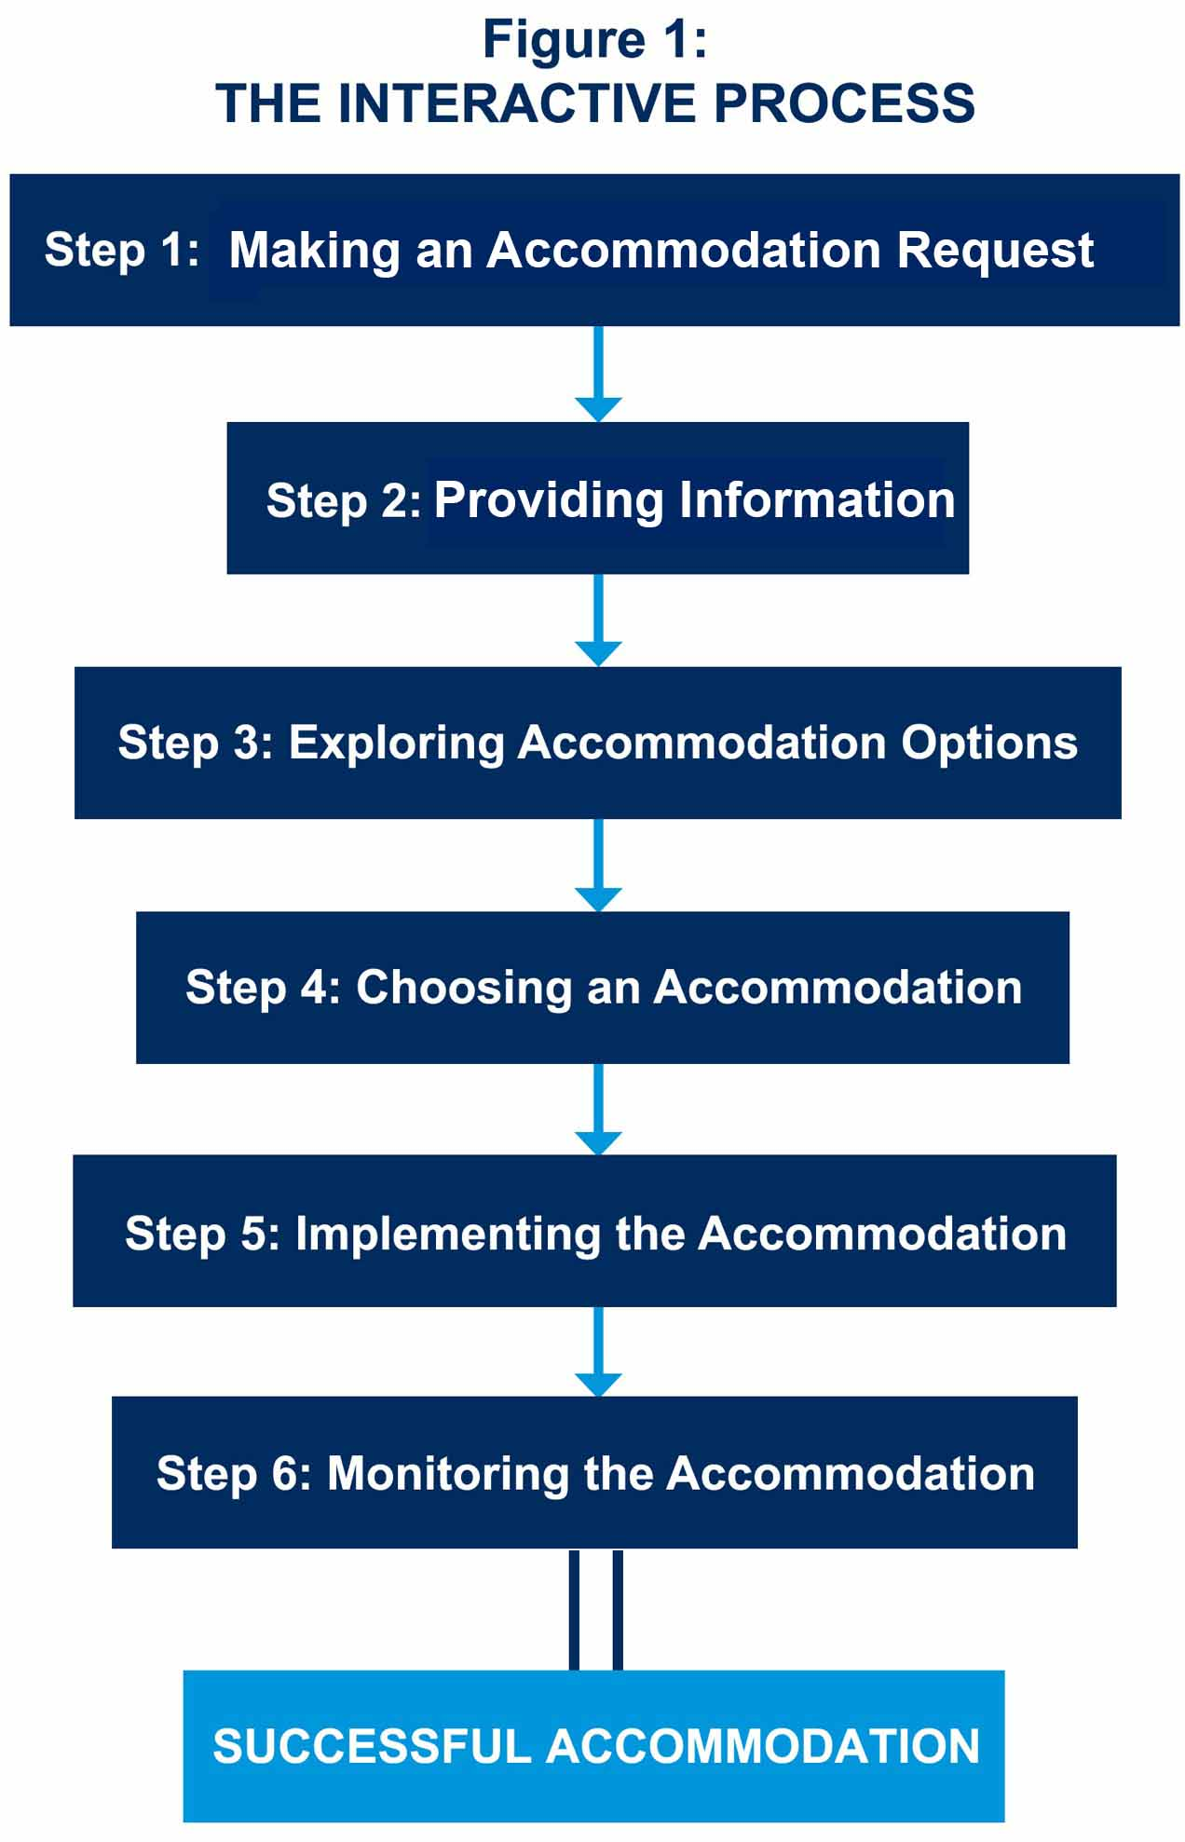
Interactive Process
JAN’s Interactive Process

Slide 36
Interactive Process
Step 1:
Making an Accommodation Request
TIPS
Make sure clients are aware of their rights under the ADA
Document the request
Be clear and specific

Slide 37
Interactive Process
An employee who is on FMLA notifies her employer that she will need additional leave after her 12 weeks of FMLA run out to recover from knee surgery.
Is this an accommodation request?

Slide 38
Interactive Process
Is this an accommodation request?
Yes.
More leave (an accommodation) is needed
Because of a medical condition

Slide 39
Interactive Process
Step 2:
Providing Information
TIPS
Describe the limitation and problem
Get information from the individual when possible
Use ADA language

Slide 40
Interactive Process
Medical Documentation:
Employee requests accommodation and the disability and/or need for accommodation is not known or obvious
Definition of disability: an
impairment that substantially
limits one or more major life
activities
Verify need for accommodation
ADA confidentiality rules

Slide 41
Interactive Process

Slide 42
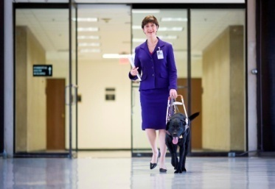
Interactive Process
A newly hired custodian uses a service animal to alert her that a seizure is coming on. She did not disclose during the phone interview and thought it would be ok to tell her supervisor on her first day of work. The employer had a “no animal” policy.
Do we have all the information we need?

Slide 43
Interactive Process
Did we provide all the information?
No.
Did not provide problem
Did not provide justification

Slide 44
Interactive Process
Step 3:
Exploring Accommodation Options
TIPS
Keep an open mind
Invite the individual to suggest options
Consult with other service providers
Use JAN when needed

Slide 45
Interactive Process
A social worker with use of only one hand has requested a work-related assistant to do all her keyboarding for case notes.
How can we figure out what else might work?

Slide 46
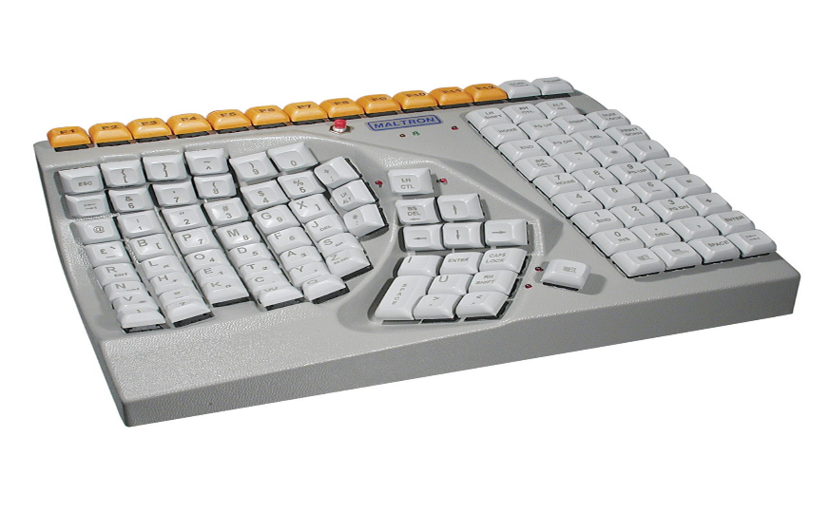
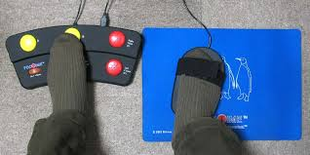
Interactive Process
How can we figure out what else might work?
Call JAN!
Perform an ergonomic assessment
Purchase speech recognition software
Provide an one-handed keyboard and a foot pedal mouse

Slide 47
Interactive Process
Step 4:
Choosing an Accommodation
TIPS
Explain the decision making process
Justify preferences
Suggest a trial period

Slide 48
Interactive Process
A customer service representative with diabetes had a strong body odor that he could not reduce until he got his diabetes under control. He has requested to work from home as an accommodation. His employer was considering putting up cubicle walls and an air purifier in his work area. His job could be done from home, but the employer was concerned about isolating the employee.
How should the employer decide which accommodation to choose?

Slide 49
Interactive Process
How should the employer decide which accommodation to choose?
Talk with the employee!
Employee preferred to work at home, so this is not forced isolation
Employee was more concerned about the cubicle/air purifier drawing attention to the smell

Slide 50
Interactive Process
Step 5:
Implementing the Accommodation
TIPS
Offer assistance during the implementation of the accommodation
Make sure to involve the individual throughout the implementation period

Slide 51
Interactive Process
A secretary with a ten-pound lifting restriction had to get bulk items weighing more than ten pounds from the storage closet. Her employer purchased her a small lifting device for office settings.
Is that it?

Slide 52
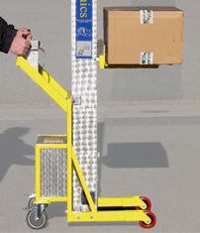
Interactive Process
Is that it?
No.
Device may need to be assembled
Employee may need instruction in use
Route of travel may need to be established

Slide 53
Interactive Process
Step 6:
Monitoring the Accommodation
TIPS
Check on effectiveness
Leave the individual in good hands
Encourage ongoing communication

Slide 54
Interactive Process
An auditor was provided speech recognition software as an accommodation a year ago. Recently the employer purchased new database software only to find out that the employee’s speech recognition software would not work with the new database.
Could the employer have avoided this problem?

Slide 55
Interactive Process
Could the employer have avoided this problem?
YES!
When purchasing new products and equipment:
Remember to consider accessibility issues
Do not forget about existing accommodations

Slide 56
Job Accommodation Network
JAN Consultants can be reached M-F 9am-6pm ET
Phone - (800) 526-7234 (voice); (877) 781-9403 (TTY)
Email - jan@AskJAN.org
Skype - Janconsultants
Text - (304) 216-8189
Chat available online at https://askjan.org/

