Slide 1
Transforming Communication with Clients: Cultural Humility, Empathy, and Compassion
Dana Brickham, PhD, CRC
Brett Kuwada, PsyD
Jennifer Bowes, MA, LMHC-A, CRC, CDMS, PGAP

Slide 2
Dana Brickham, PhD, CRC
Dr. Dana Brickham completed her Ph.D. in Rehabilitation Psychology at the University of Wisconsin, Madison and has been a Certified Rehabilitation Counselor for 15 years and Licensed Professional Counselor for 7 years. She currently works as an Associate Professor and the Clinical Coordinator at Western Washington University (Everett) for the Graduate Program in Rehabilitation Counseling. Her passion involves working with people to integrate self-care, mindfulness, and cultural humility practices into their life, as well as the lives of the people that they work with. She also has an interest in deepening counseling skills and strengthening the therapeutic relationship. Dr. Brickham has presented at numerous conferences including the National Council on Rehabilitation Education (NCRE), the American Psychological Association Conference, the National Conference on Race and Ethnicity in Higher Education (NCORE), the Resilient Intellectuals Seeking Equity (RISE), International Association of Rehabilitation Professionals (IARP)-Washington Chapter, and Hero House-Bellevue.

Slide 3
Brett Kuwada, PsyD
Dr. Brett Kuwada is known for his ability to facilitate the creation of wonderful spaces for insight and personal growth. He is a passionate leader with many years of experience in both private and public sectors. He has a strong ability to make the complex simple and understandable, while not losing the depth and importance of the topic at hand. He has been described as being very warm and caring, with a keen ability to bring calm in the face of chaos. Dr. Kuwada completed his Doctor of Psychology at the American School of Professional Psychology at Argosy University, and completed his doctoral internship work at the University of Washington Counseling Center. He received his master’s degree in Clinical Psychology from the Washington School of Professional Psychology, and his bachelor’s degree from Western Washington University.
Dr. Kuwada is an instructor for Western Washington University’s Graduate Program in Rehabilitation Counseling. He is also a professor In the Psychology Department at Everett Community College. Prior to that, he spent 9 years as a counselor and professor for the college. Dr. Kuwada is also President of The CHEC Center, an organization focused on bringing about DEI change by using Cultural Humility, Empathy and Compassion. He has done numerous workshops for many public institutions, corporations, and presented at various conferences focused on diversity, equity, and inclusion. His recent works have included a full day pre-conference workshop at the National Conference on Race and Ethnicity in Higher Education (NCORE), workshop series for the Ivy Tech College system, workshop for the University of Washington CCER Department, as well as keynote addresses for the Human Rights Education Institute (HREI), Idaho Community College Welcome Week, and a workshop for the 5th Annual Step UP: Moving Racial Equity Forward Conference.

Slide 4
Jennifer Bowes, MA, LMHC-A, CRC, CDMS, PGAP
Jennifer Bowes earned a Bachelor of Arts in Counseling Psychology from The Evergreen State College and a Master of Arts in Rehabilitation Counseling from Western Washington University. She has worked as a Counselor/Case Manager in various settings, including at a group home for teen-aged girls, at a mental health agency working with adults with mental illnesses, and as a vocational counselor for individuals with physical disabilities. She has been an owner of two vocational firms since 2002 and she currently practices as a sole proprietor at Bowes Vocational, LLC in Woodinville. In 2007, Jennifer began completing vocational evaluations for individuals who have been injured on the job, as well as for individuals with mental health diagnoses. Jennifer served on the IARP-WA Board from 2012-2019. She provides vocational expert testimony for Social Security Disability Hearings. Jennifer was recently an invited guest speaker at the Racial Equity Step Up 2021—Leadership Snohomish County Conference where she presented on the intersectionality of disability and race.

Slide 5
Introduction
Rehabilitation professionals strive to help people with disabilities live their best life possible
Communication is at the heart of our work
The Cultural Humility, Empathy, and Compassion model (Kuwada, 2014, 2015) provides a framework for having conversations with our clients and each other in a more connected way

Slide 6
Learning Objectives
Participants will learn about multiple minoritized identities in relation to intersectionality in rehabilitation settings
Participants will learn a new framework for having more meaningful communication with rehabilitation clients using the Cultural Humility, Empathy, and Compassion (CHEC) Model
Participants will learn how to apply the CHEC model in their conversations with clients and others
Participants will learn to practice these skills in dyad conversations

Slide 7
Cultural Competence
Definition
Assessment
Who is culturally competent?
What if you aren’t culturally competent?

Slide 8
Cultural Humility Seminal Article
Cultural Humility Versus Cultural Competence…(Tervalon & Murray-Garcia, 1998)

Slide 9
Three Dimensions of Cultural Humility
Lifelong learning & critical self-reflection
Recognize and challenge power imbalances
Institutional accountability

Slide 10
Lifelong Learning & Critical Self-reflection
Coming from a place of knowing that we don’t know
Being able to accept our own limitations
To be cognitively flexible and open to new interpretations of seemingly old experiences
Encouraged to be curious tied to that place of not knowing
Openness – we push ourselves to be open to those around us who want to learn about us

Slide 11
Lifelong Learning & Critical Self-reflection
All leads to lifelong learning and ongoing critical self-reflection
We hold ourselves accountable for constant learning and curiosity to help understand those around us
Frees us from feeling that we have to be experts on others and their culture

Slide 12
Recognize & Challenge Power Imbalances
We attempt to recognize when we are in a position of power and make attempts to neutralize this imbalance
We notice when there is a power imbalance in systems and acknowledge this difference, also taking responsibility to point out and advocate

Slide 13
Institutional Accountability
At an institutional level, we need to encourage this philosophy/culture
If the system has embraced this philosophy, it will be much easier for the individuals to feel safe with the practice
Future training

Slide 14
Empathy
The ability to understand and share the feelings of another (dictionary.com)
A key skill is making sure we are able to do our best to understand what it might feel like in that person’s shoes
We can guess, however, we really don’t know without an open conversation
If we feel like the victim, we attempt to have empathy for the perpetrator
If we are the perpetrator, we attempt to have empathy for the victim

Slide 15
Compassion
A feeling of deep sympathy for another who is stricken by misfortune, accompanied by a strong desire to alleviate the suffering (dictionary.com)
When we know someone has been hurt, by us or someone/something else, we ask how we might help
When someone recognizes we are hurt, we try to be open for dialogue

Slide 16
Cultural Humility Empathy & Compassion (CHEC)
A philosophy for interaction
Step back and allow others’ identities to have space
Being grounded in self and continued self-awareness

Slide 17
The Practice of Cultural Humility Empathy & Compassion (CHEC)
Starts with understanding self
Recognizing your own reactions (emotionally, sensationally)
Recognizing your own thoughts
Recognizing your own behaviors
What impact do these have with your ability to connect to people?
How do you want these connections to look and feel?
If something impedes that connection, what needs to change within me?

Slide 18
Suspend Judgment
Suspend/withhold judgment
Recognizing Biases
Hesitation most likely indicates some conscious or unconscious bias
Understanding current beliefs
How do you know – source of information

Slide 19
Listen
How can you tell when someone is listening deeply?
Paraphrasing what you hear
Active listening
Posture
Non-verbals

Slide 20
Be Curious
Embrace curiosity
Thoughtful
Questions
Respectful questions vs. disrespectful questions

Slide 21
Case Analysis
Mickie Jagger
Injured in 2017
Lumbar condition with surgical intervention; bilateral Carpal Tunnel Syndrome, Carpal Tunnel release, partially successful; light level RFC; occasional handling left non-dominant and frequent on right dominant hand; frequent fingering bilaterally
Attempted return to work, but ultimately was terminated from employer of injury
Singular work history as a carpenter
42 years of age
High school diploma and completed apprenticeship – journeyman level
What comes to you when you get this referral/file/case?

Slide 22
Applying CHEC
Things to consider for discussion
What preconceptions did you make about/for this person
Such as gender and gender identity, did you make/create a plan of action/vocational plan, assumptions of their motivation level or likely interests, thoughts about previous similar clients and superimposing what you did with that client, etc.
How might these impact developing a relationship with the client and influence how you communicate?
What might your actual meeting with the client be like if you came in without your preconceived plan
How do you listen to your client, without thinking about or imposing your agenda?
How do you use empathy and compassion with your client, even in the face of barriers?
How would you create your assessment and plan collaboratively based on who they are, rather than the deadlines/expectations/requirements of the “referral”?
How do you stay away from the “yabbuts”?
Breakout – 10 minutes

Slide 23
CHEC Summary
CHEC frees us from having to be the experts
Puts VR professionals in the space of being a life-long learner and engaging in critical self-reflection
Being conscious of pre-conceptions
CHEC Tool: Suspending Judgment and pushing yourself into that space of discomfort
Being cognitively flexible and open to new interpretations of seemingly old experiences
CHEC Tool: Listening
Being encouraged to be curious tied to that place of not knowing
CHEC Tool: Curiosity
Openness in communication and connecting more deeply to your client
CHEC Tool: Growing & embracing the connection

Slide 24
Thrive from Connections
Connection
Gratitude
Embrace the moment
Think Namaste
The divine in my heart connects with the divine in your heart

Slide 25
What does this practice lead to in your organizations & in your work with clients?
Respect
Open communication
Accuracy
Clear expectations
Deeper connections
Supportive environment
Daily Practice

Slide 26
Humility & Humanity
Ultimately, this work strips away the socially constructed preconceptions about those around us
Allows for authentic and genuine connection to the human in everyone
Fosters connection and care

Slide 27
Thank You IARP & LNI!
Please visit us at checcenter.org
Contact us to join our email updates for our bi-monthly CHEC In trainings!
info@checcenter.org
Next CHEC In: December 6th, 6:00 p.m. – 7:30 p.m.

Slide 28
Intro to Activity
Visualize “THAT client” and the factors that trigger you
Such as race/ethnicity, length of disability, disability conviction, physical appearance, age, the other professionals connected to the claim, anything that comes to mind.
Notice your natural immediate reaction when you think of that client
Cognitive, emotional, and physiological response
From those responses, what behaviors or actions emerge (how does it affect your interaction with that person)
Jot down what stood out for you – face your biases

Slide 29
Applying CHEC
Using that exploration of triggers, apply what you’ve learned from the CHEC model to peel away the impact of those biases
Find more cultural humility – what you don’t “know” about this person
Find more empathy – their past experiences that influence how they come into your office
Find more compassion – Let go of your past experiences that interfere in connecting with this client
Compare what changed for you: thoughts, emotional reactions, physiological reactions, and ultimately, your behaviors
Breakout – discuss/explore how your experience changed from the first to second brainstorming
What was easy? What was hard? Where might you still feel stuck?

Slide 30
Intersectionality
A dive into the research
Questions?

Slide 31
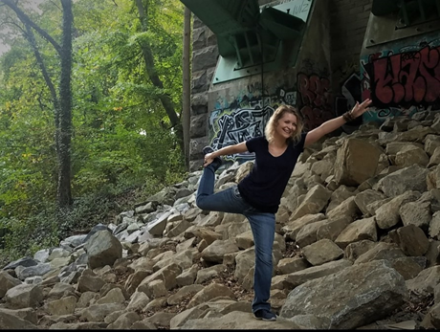
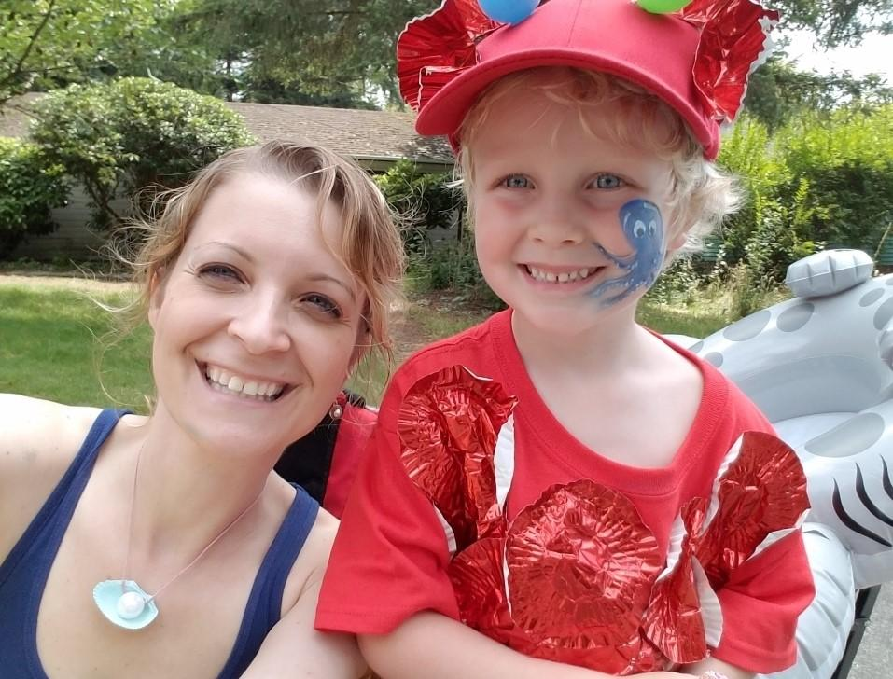
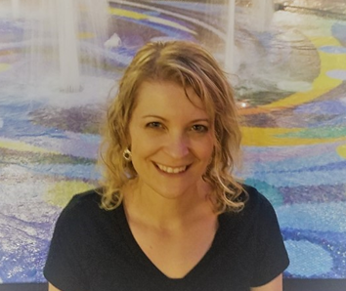
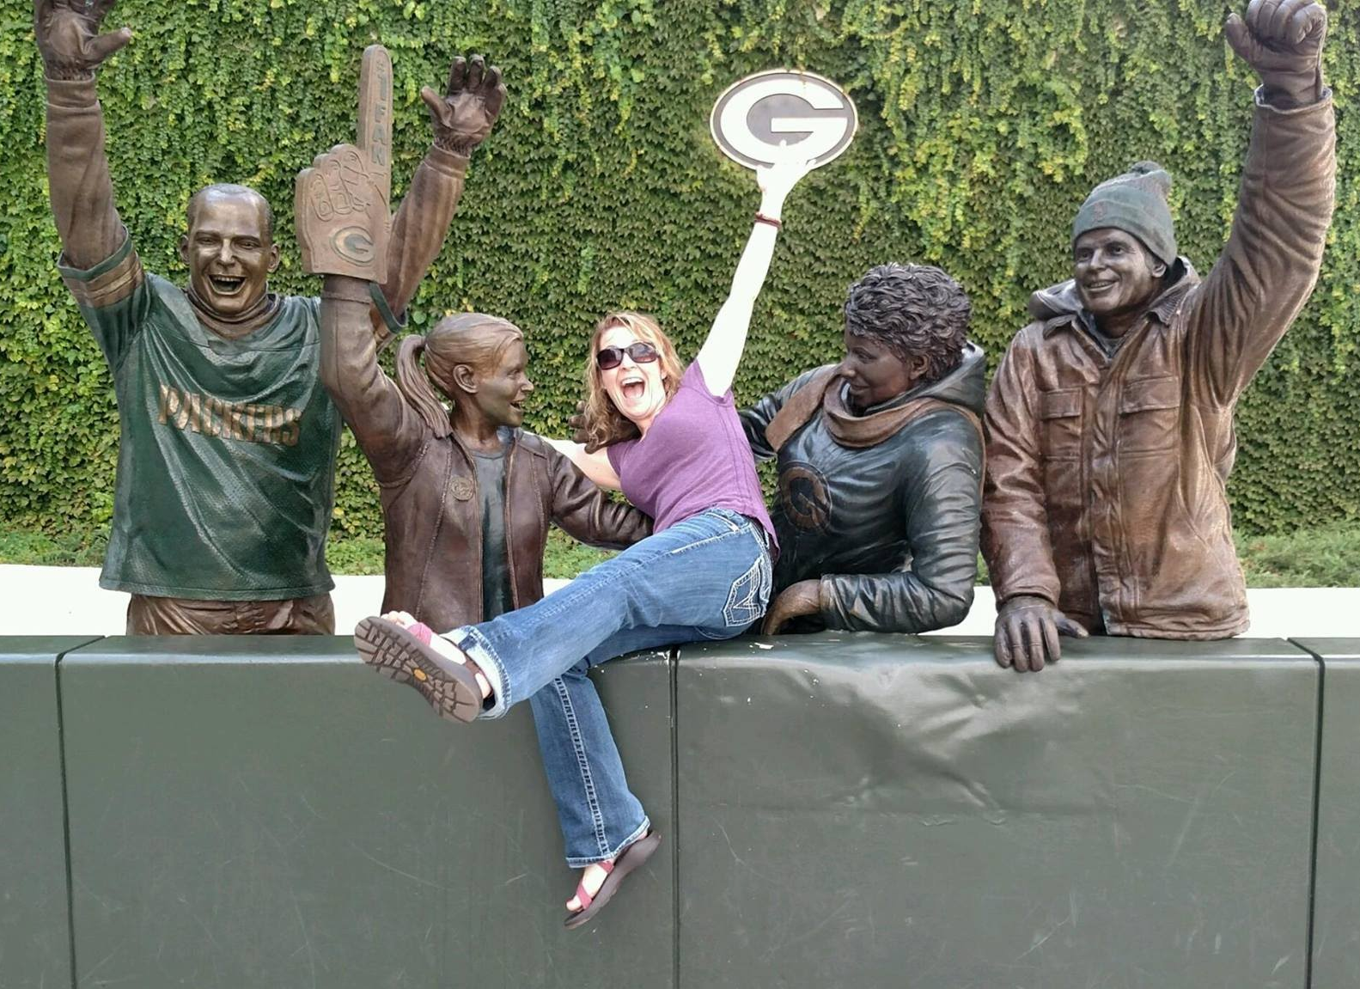
Dana and her son dressed as a rainbow fish at a parade
Dana doing a yoga pose
Dana Brickham, PhD, CRC
Dana@checcenter.org Dana.Brickham@wwu.edu
Dana doing the Lambeau Leap at
Green Bay Packers Stadium

Slide 32
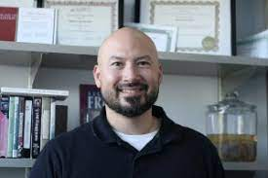
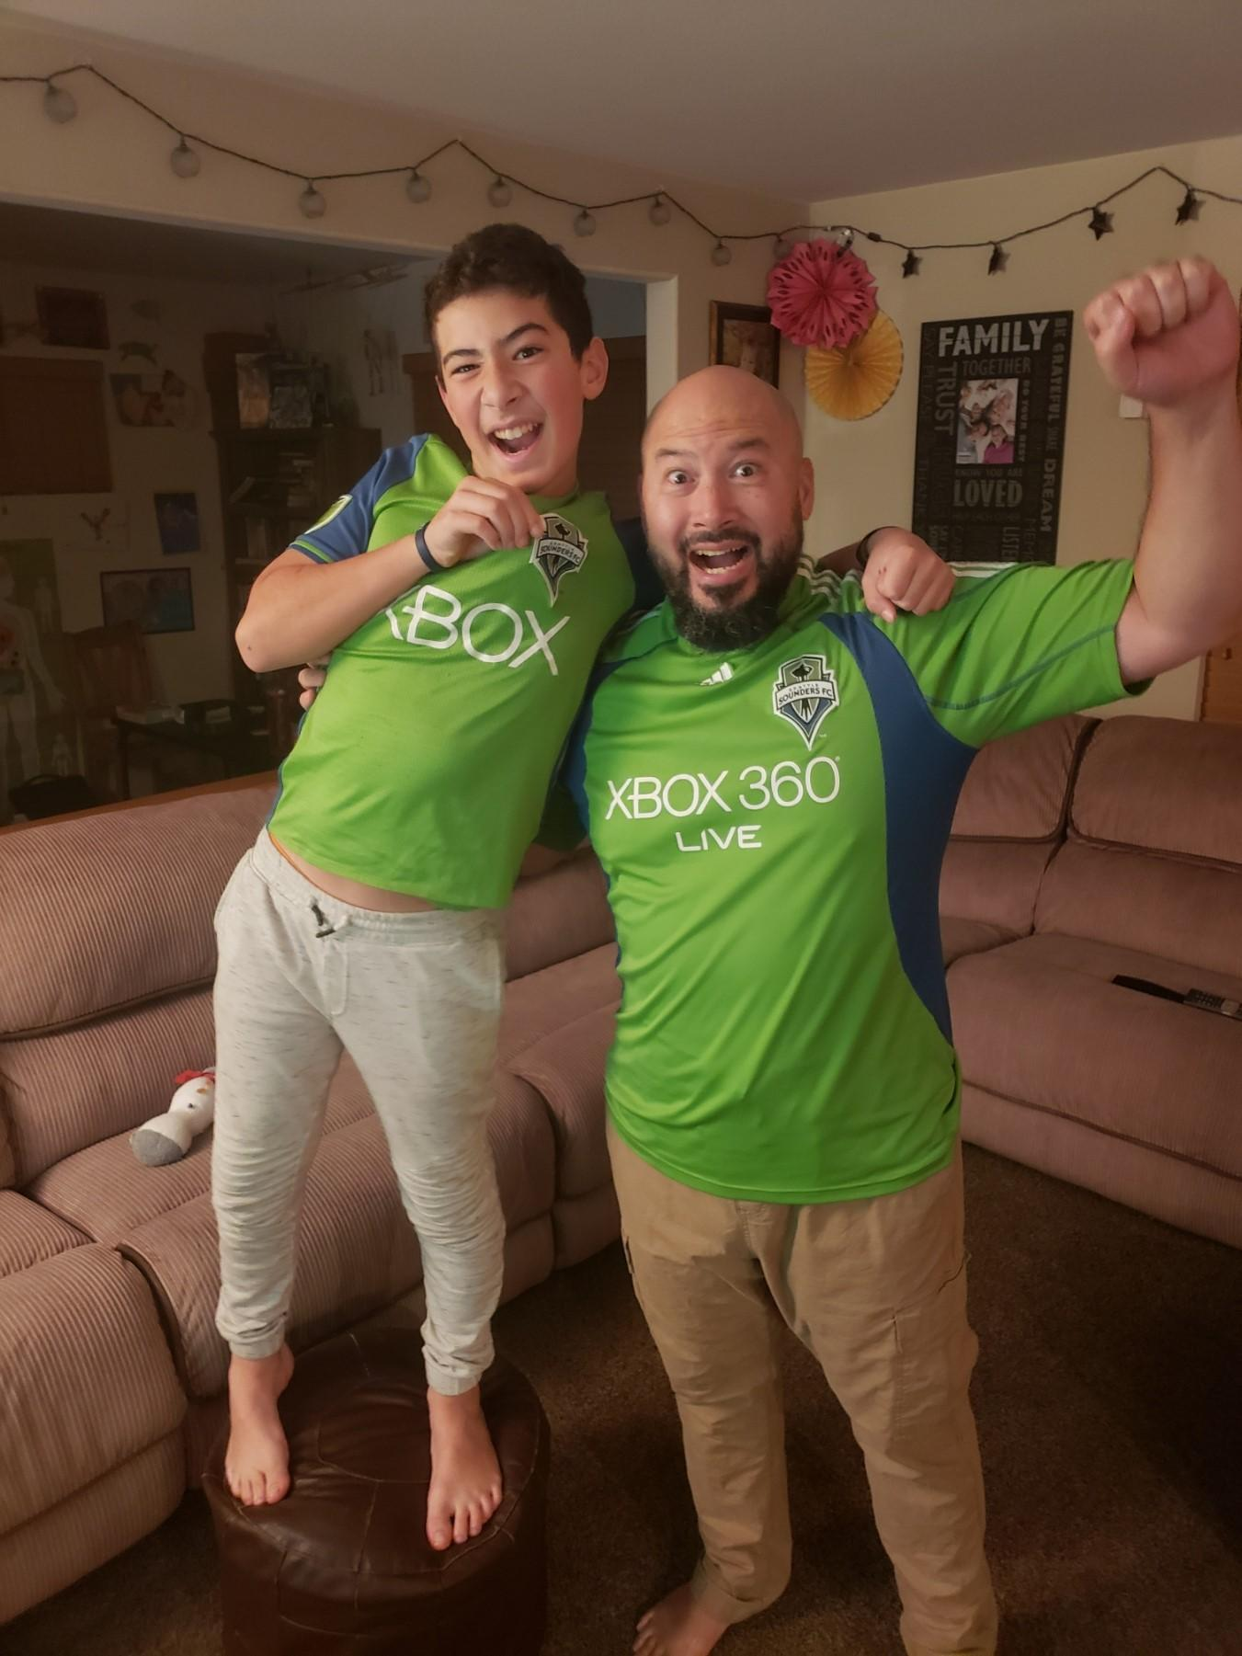
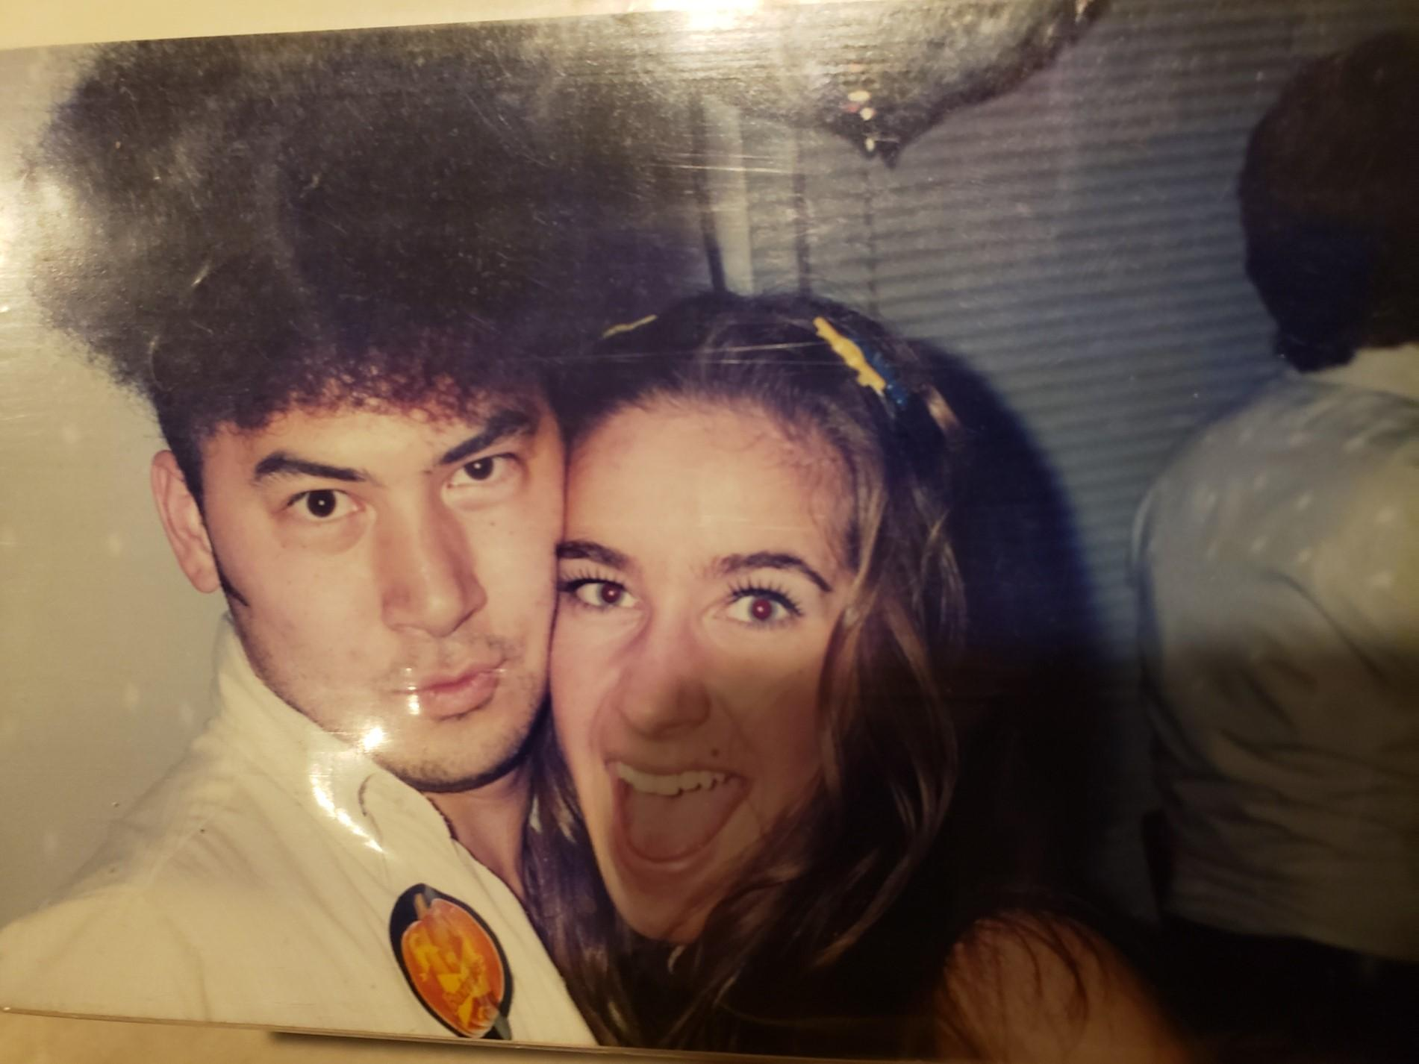
Brett & His Daughter Kinley Catching a Crab
Brett Kuwada, PsyD
Brett & His Wife Michele Partying Disco Style
Brett & His Son Kyler Celebrating a Sounders Win
Brett@checcenter.org

Slide 33
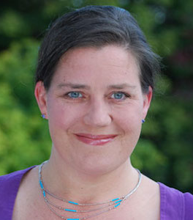
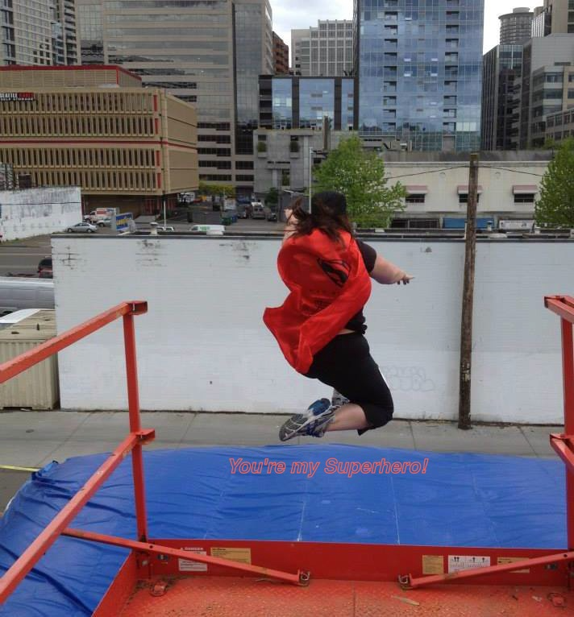
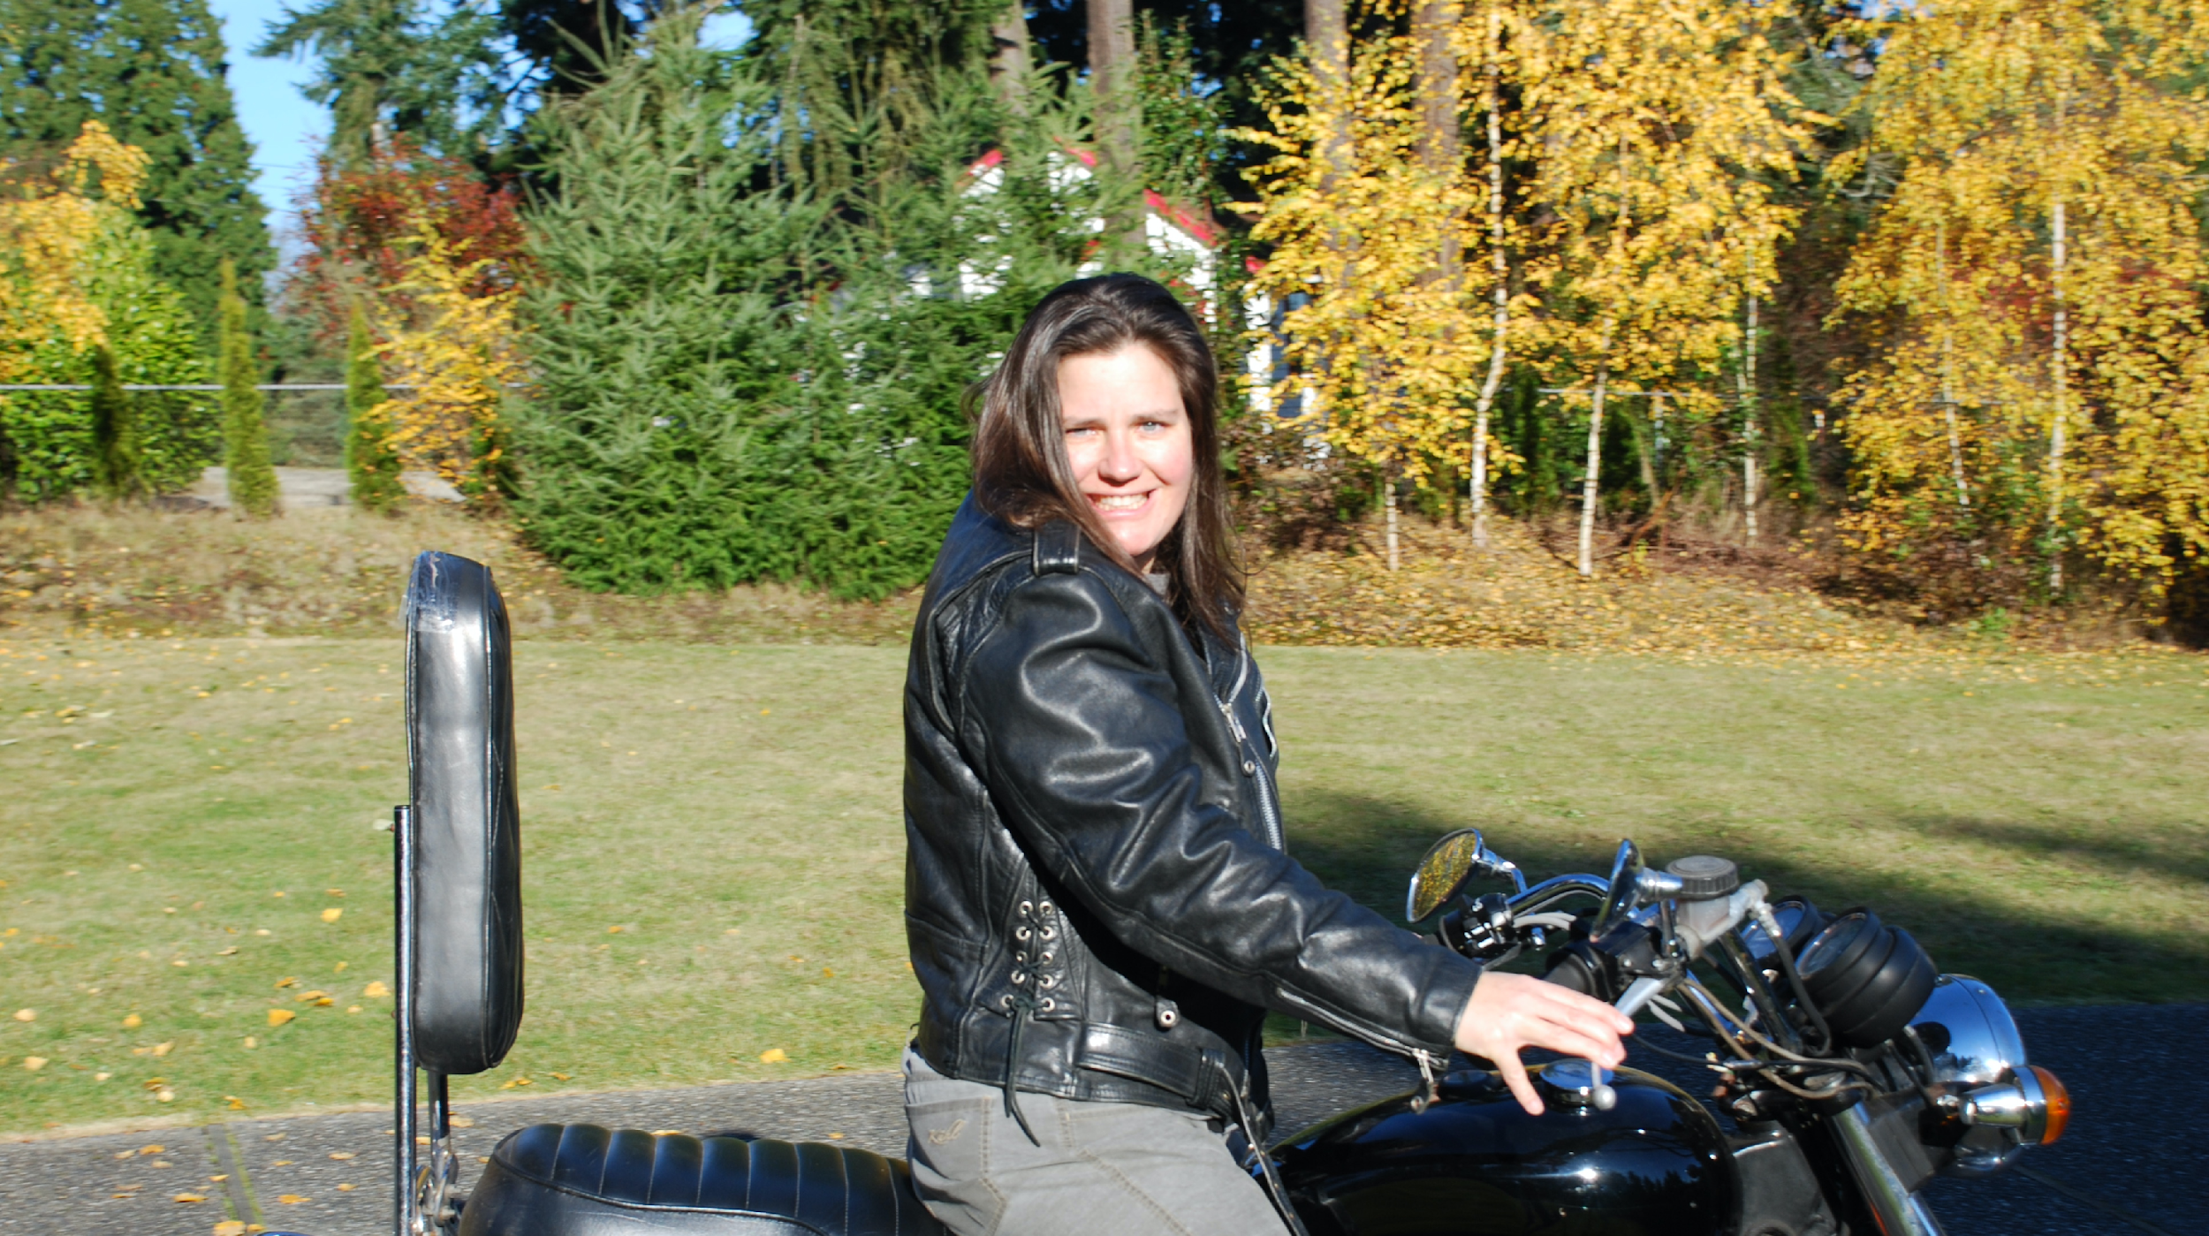
Scuba in Bonaire
Great Urban Race Seattle
Wild Parrot – New Zealand
Born to Ride (1979 Bonneville)
Jennifer Bowes, MA, LMHC-A, CRC, CDMS, PGAP, She/Her
Jennifer@bowesvocational.com Jennifer@checcenter.org

Slide 34
Thank You IARP & LNI!
Please visit us at checcenter.org
Contact us to join our email updates for our bi-monthly CHEC In trainings!
info@checcenter.org
Next CHEC In: December 6th, 6:00 p.m. – 7:30 p.m.

Slide 35
References
Bureau of Labor Statistics. (2021, February 24). Persons with a disability: Labor force characteristics – 2020. Retrieved from https://www.bls.gov/news.release/disabl.nr0.htm
Coaston, J. (2019, May 28). The intersectionality wars. Vox. Retrieved from https://www.vox.com/the-highlight/2019/5/20/18542843/intersectionality-conservatism-law-race-gender-discrimination
Lightner, L. (n.d.). 39 ableist microaggressions you might encounter at an IEP meeting – think before you speak!. A day in your shoes. Retrieved from https://adayinourshoes.com/ableist-microaggressions-iep-meeting/
Lu, W. (2016, September 26). 13 microaggressions people with disabilities face. Bustle. Retrieved from https://www.bustle.com/articles/186060-13-microaggressions-people-with-disabilities-face-on-a-daily-basis
National Disability Institute. (2020, August). Race, ethnicity and disability: The financial impact of systemic inequality and intersectionality. Retrieved from https://www.nationaldisabilityinstitute.org/wp-content/uploads/2020/08/race-ethnicity-and-disability-financial-impact.pdf
Rahman, L. (n.d.). Disability language guide. Stanford. Retrieved from https://disability.stanford.edu/sites/g/files/sbiybj1401/f/disability-language-guide-stanford_1.pdf

