Slide 1
Everything You Wanted to Know about VA
and a bunch of stuff you didn‘t know you wanted to know!
Linda Parker, MSW, MA
Assistant Director, Little Rock Regional Office

Slide 2
A Little About Me
1st entered the professional world as a Clinical Social Worker
Started in Voc Rehab in the early 19XXs
Began my career with VA as a Contract Counselor in 2000
Hired on as a Voc Rehab Counselor in 2004 in LA
Went to Washington DC in 2007 as a Training Specialist
Moved to Salt Lake City in 2010 as VR&E Officer
Assumed the Assistant Director position in Little Rock in 2013
Masters in Social Work from San Diego State
Masters in Counseling (Rehab Emphasis) from University of Arkansas Little Rock

Slide 3
What is VA? Department of Veterans Affairs
To care for him who shall have borne the battle and for his widow, and his orphan
Established as an independent agency under the President by Executive Order 5398 of July 21, 1930
Elevated to Cabinet level agency on March 15, 1989 (Public Law 100-527)

Slide 4
VA Stats
Second Largest Cabinet level agency after Department of Defense
227,085 (2016) employees work across VA

Slide 5
What is VA?
Three administrations
Veterans Health Administration (VHA)
Veterans Benefits Administration (VBA)
National Cemetery Administration (NCA)
Fort Roots VA Campus, North Little Rock, AR

Slide 6
VHA
Largest integrated health care system in the United States
1,243 health care facilities
170 VA Medical Centers
1,063 outpatient sites of care
More than 9 million enrolled Veterans
Puget Sound VA Healthcare System, Seattle, WA

Slide 7
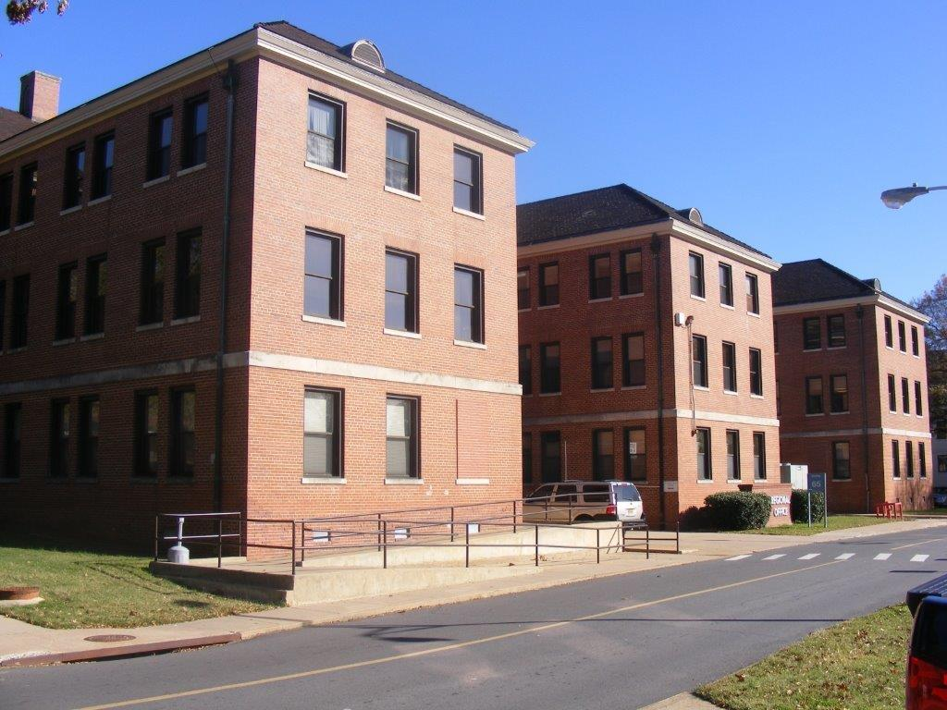
What is VA?
Three administrations
Veterans Health Administration (VHA)
Veterans Benefits Administration (VBA)
National Cemetery Administration (NCA)
Little Rock Regional Office
Fort Roots, North Little Rock, AR
https://benefits.va.gov/benefits/

Slide 8
VBA
56 Regional Offices, including Puerto Rico and Manila
27,000 employees
Jackson Federal Building, Seattle, WA

Slide 9
What is VA?
Little Rock National Cemetery
Comprised of three administrations
Veterans Health Administration (VHA)
Veterans Benefits Administration (VBA)
National Cemetery Administration (NCA)
https://www.cem.va.gov
Notes:
135 national cemeteries in 40 states (and Puerto Rico) as well as 33 soldier's lots and monument sites

Slide 10
Eligibility for VHA Healthcare
Active Duty in branch of Armed Services or Guard/Reserve called to active duty
Period and length of service (post 1980 – 24 months)
Separated under Honorable or General under Honorable Conditions
Eligibility Determination tool
http://hbexplorer.vacloud.us

Slide 11
Eligibility for VBA Comp & Pen Benefits
Service-connection:
Disease or condition incurred or aggravated while serving in the Uniformed Services on active duty; Presumptive disabilities (e.g., Agent Orange related diseases); both physical & mental conditions or diseases
Discharged under other than dishonorable conditions
At least 10% disabled by an injury or disease (percentage of disability tied to degree of impairment)
https://benefits.va.gov/benefits/

Slide 12
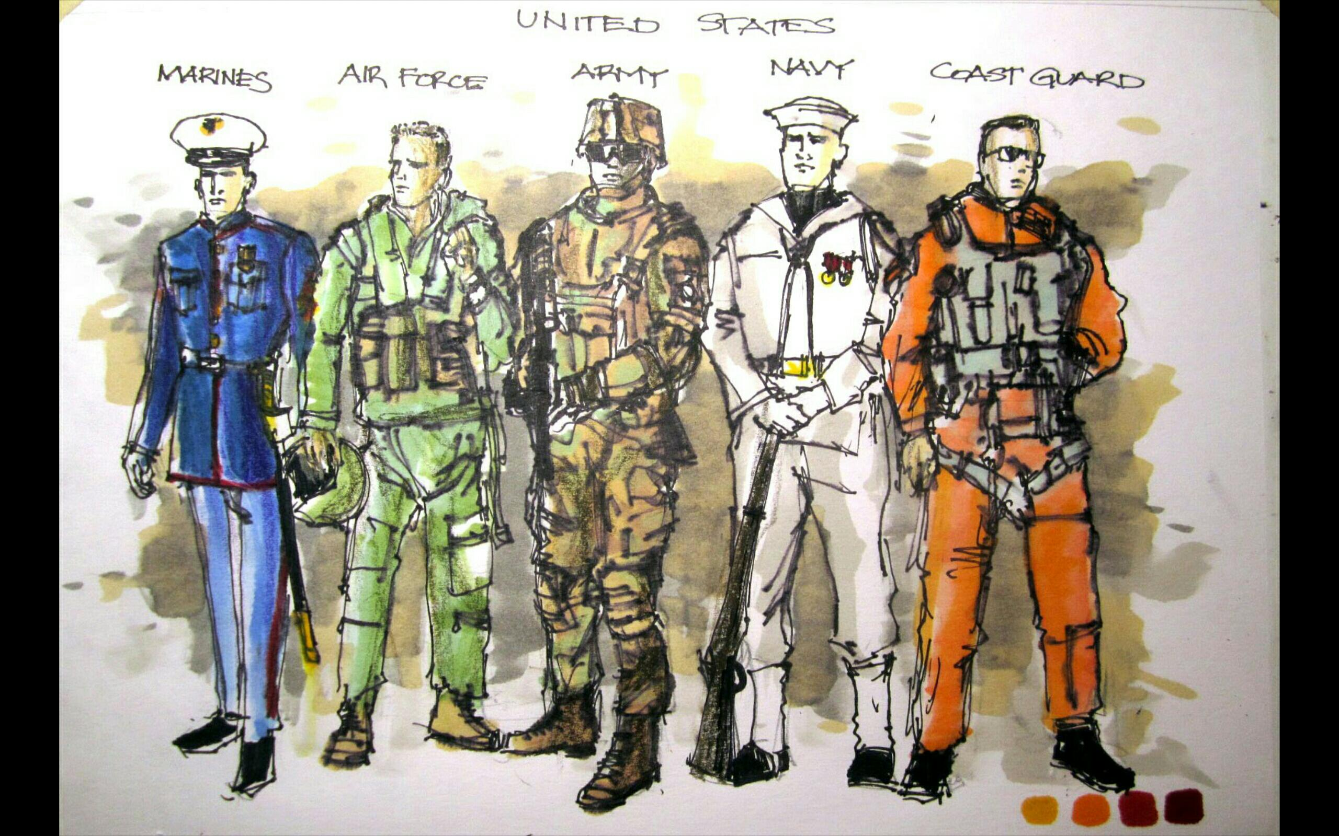
eBenefits
https://www.ebenefits.va.gov/ebenefits/homepage
A Service of the Department of Veterans Affairs and the Department of Defense

Slide 13
VBA Benefits
Compensation (Disability, Dependency)
Pension and Fiduciary (Disability, Survivor)
Insurance (Life, Mortgage)
Home Loan Guaranty
Education Programs (GI Bill, Retraining, and Educational Assistance Programs)
Vocational Rehabilitation and Employment

Slide 14
Vocational Rehabilitation and Employment (VR&E)
A master's degree in rehabilitation counseling that included an internship; OR
Working as a Vocational Rehab Counselor (VRC) with VBA

Slide 15
Vocational Rehabilitation and Employment (VR&E)
A master's degree in counseling psychology (or related field)
That includes an internship in rehabilitation counseling; supplemented by at least 30 semester hours of course work that MUST have emphasized voc rehab counseling;
OR
Working as a Vocational Rehab Counselor (VRC) with VBA
Notes:
foundations of rehabilitation counseling, human growth and development, counseling theories and techniques, vocational assessment, career development, job placement, case management, and medical/psycho-social aspects of disability

Slide 16
Vocational Rehabilitation and Employment (VR&E)
A master's degree listed in 1 or 2 WITHOUT a rehabilitation counseling internship and
Experience that must include one full year in direct delivery of vocational rehabilitation services to adults with disabilities in rehabilitation programs and
Supervised by a professional in vocational rehabilitation or a closely related professional field
Working as a Vocational Rehab Counselor (VRC) with VBA

Slide 17
VBA VRC GS9 - GS12 Salary
OPM salary tables https://www.opm.gov/policy-data-oversight/pay-leave/salaries-wages/2018/general-schedule/
Grade | Step 1 | Step 2 | Step 3 | Step 4 | Step 5 | Step 6 | Step 7 | Step 8 | Step 9 | Step 10
9 | 50598 | 52285 | 53971 | 55658 | 57345 | 59031 | 60718 | 62405 | 64091 | 65778
11 | 61218 | 63259 | 65299 | 67340 | 69381 | 71422 | 73463 | 75504 | 77545 | 79586
12 | 73375 | 75821 | 78267 | 80713 | 83159 | 85605 | 88050 | 90496 | 92942 | 95388
Rest of US

Slide 18
Working as a VBA Contract VRC
Prime Contractor in Northwest
The Consolidated Rehab Group, Inc. (TCRG)
John Houck
jhouck@tcrgpro.com

Slide 19
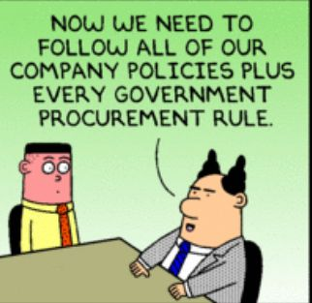
Working as a VBA Contract VRC
Prime Contractor in Northwest
The Consolidated Rehab Group, Inc. (TCRG)
John Houck
jhouck@tcrgpro.com

Slide 20
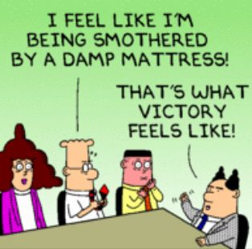
Working as a VBA Contract VRC
Prime Contractor in Northwest
The Consolidated Rehab Group, Inc. (TCRG)
John Houck
jhouck@tcrgpro.com

Slide 21
Federal Employment for Veterans
OPM: Special Veterans Authorities https://www.opm.gov/policy-data-oversight/hiring-information/veterans-authorities/
Feds Hire Vets https://www.fedshirevets.gov/Index.aspx

Slide 22
VA Resources
Federal Guide to Benefits https://www.va.gov/opa/publications/benefits_book.asp
VHA Eligibility Determination tool http://hbexplorer.vacloud.us
VHA Health Benefits https://www.va.gov/healthbenefits/resources/publications/hbco/hbco_introduction.asp
VBA Summary of Benefits https://www.benefits.va.gov/BENEFITS/Benefits_Summary_Materials.asp
CNA burial benefits https://www.cem.va.gov

Slide 23
VA Resources
eBenefits https://www.ebenefits.va.gov/ebenefits/homepage
MyHealtheVet https://www.myhealth.va.gov/mhv-portal-web/home
The VA Web Site www.va.gov OR www.vets.gov

Slide 24
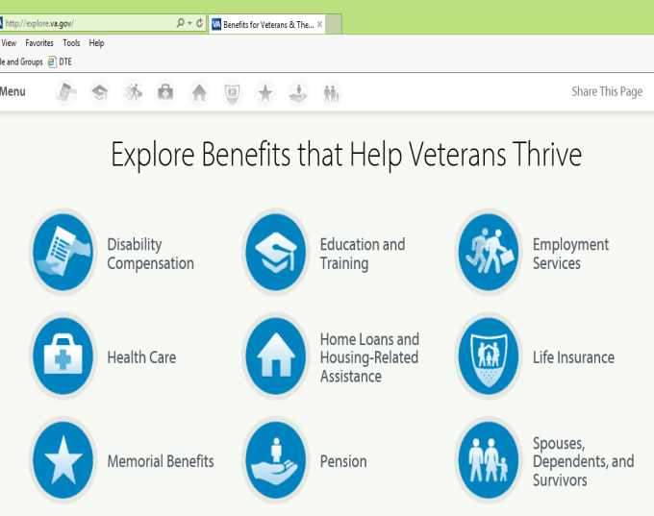
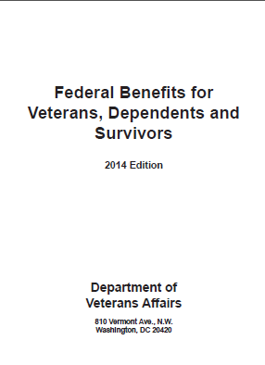
What Are My Benefits? Am I Eligible?
Explore VA Benefits Online
National Call Center
Federal Guide to Benefits
1-800-827-1000
Videos & eligibility information in 30 seconds
http://explore.va.gov
Located in VBA Regional Offices, select field sites https://www.va.gov/opa/publications/benefits_book.asp

Slide 25
OPM Resources
Salary Tables https://www.opm.gov/policy-data-oversight/pay-leave/salaries-wages/2018/general-schedule/
Special Veterans Authorities https://www.opm.gov/policy-data-oversight/hiring-information/veterans-authorities/

Slide 26
QUESTIONS ?

Slide 27
Linda Parker
linda.parker4@va.gov

